Slide 1
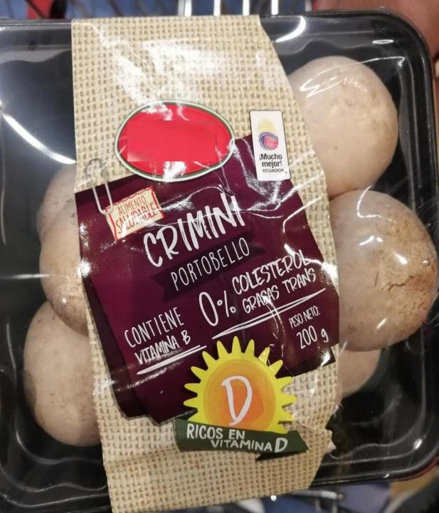
54%
Of consumers want to see nutrition information on produce labels
Consumers would like to see many things on fruits and vegetable labels, but nutrition information easily tops the list, at 54% of shoppers.
This mushroom package label example from Ecuador highlights Vitamin B, Vitamin D, 0% cholesterol and trans fats and gently reminds shoppers mushrooms are a healthy food choice.
Source: Southeast Produce Council and 210 Analytics, What’s New 2021
Notes:
Text for LinkedIn post:
#Produce marketers have to balance many things. Consumers want to be able to see the product they are buying but at the same time, they have a long list of items they would like to see on the package label, according to the 2021 What’s New Study by the @Southeast Produce Council and @210 Analytics. #Nutrition information tops the list, desired by 54% of consumers, according to the study. This is an important opportunity for #mushrooms to point consumers to the many favorable properties from being highly #sustainable to highly nutritious.
This mushroom label from Ecuador does an excellent job highlighting all the important things as it relates to mushrooms and nutrition. It references Vitamins B and D as well as the absence of cholesterol and trans fats. It also reminds shoppers mushrooms are a healthy food choice. All this and still great visibility of the mushrooms inside the package.
USDA questions:
- Can we show the full label without any blurring when it is international?

Slide 2
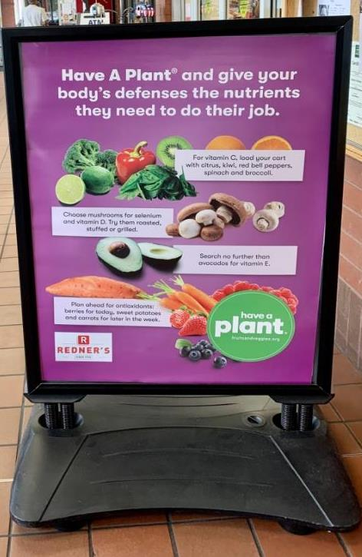
33%
Because of COVID-19, I have a bigger focus on my immunity
The importance of immunity increased for 1 in 3 consumers amid the pandemic. People most associate Vitamin C (59%), Vitamin D (48%), antioxidants (33%) and Vitamin B (30%) with immunity. Yet, only 15% of consumers recognize mushrooms as being able to help boost immunity versus 39% naming citrus fruits. Educate shoppers about fresh produce’s role in supporting the immune system, as done beautifully by Redner’s and the Have a Plant campaign, shown to the right.
Source: Datassential
Notes:
As the COVID-19 pandemic enters its third year, consumers remain focused on #immunity, according to data insights firm @Datassential. They found that 33% of consumers have a bigger focus on immunity because of coronavirus. The Datassential study followed up to understand which foods and beverages, and which nutrients, consumers associate with supporting their immune system. Perhaps unsurprising, citrus fruits topped the list, mentioned by 39% of consumers. The entire top half of the list is dominated by #produce items. #Mushrooms also made the list, mentioned by 15% of consumers. In terms of nutrients, consumers focus in on Vitamin C (59%), Vitamin D (48%), antioxidants (33%) and vitamin B (30%). Mushrooms feature both Vitamin B and D.
Retailers have upped their game in educating consumers about nutrition and immunity. The “Have a Plant Campaign” by the @Produce for Better Health Foundation joined with @Redner’s for a great example of cross-category education about the benefits of Vitamins C, D, E and antioxidants on signage outside the door as well signage inside the produce department. A shining example of educating consumers looking to learn more about immunity.

Slide 3
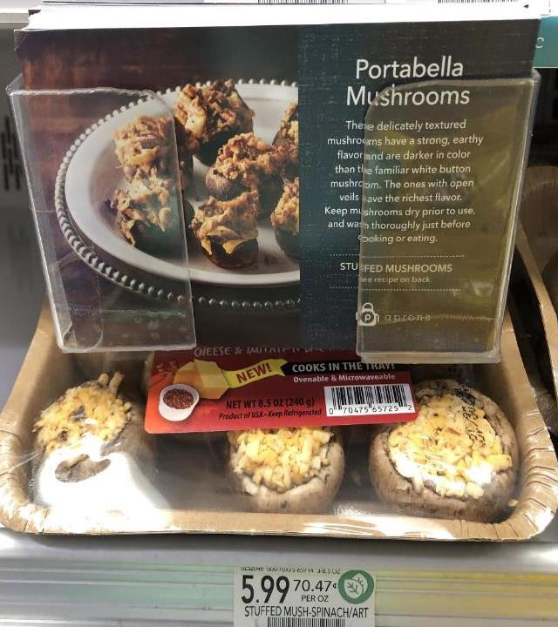
38%
Want to see taste and texture descriptions for new/lesser-known fruits and vegetables
Consumer desire for more information keeps produce marketers on their toes. Publix’ portabella mushroom flyer is a great example of providing shoppers with taste and texture descriptions:
“These delicately textured mushrooms have a strong, earthy flavor and are darker in color than the familiar white button mushrooms. The ones with open wells have the richest flavor.”
Source: Southeast Produce Council and 210 Analytics, What’s New 2021
Notes:
LinkedIn text:
Seemingly overnight, meals went from being split between eating out and preparing something at home to becoming largely home-centric. According to @IRI, 80% of meals are still prepared at home today. Experimentation was a big theme in 2020 and 2021 as consumers were tired of the same-old. People tried new items, new combinations and new recipes but to avoid buyers remorse, 38% of consumers would love to see taste and texture descriptions for new or perhaps lesser-known fruits and vegetables. This according to the 2021 What’s New Study by the @Southeast Produce Council and @210 Analytics.
Package label real estate is limited and @Publix found a great way around that using postcard size flyers at the shelf describing portabella mushrooms. White button mushrooms make up the largest share of sales, but getting people to purchase a greater variety is often what leads to more purchases and greater baskets. Publix does an excellent job describing the strong, earthy flavor, color and texture and which ones have the richest flavor — opening the door to experimentation just a little wider.
USDA question:
- Is it ok that you see a bit of the package label beneath that does not show the logo or brand?

Slide 4
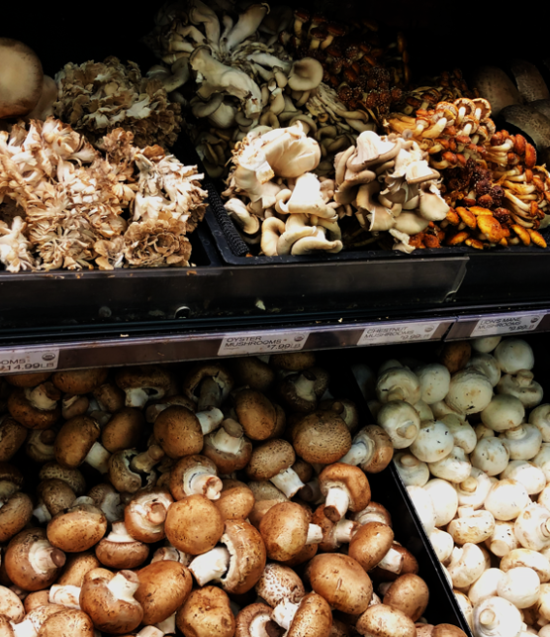
83%
Of consumers like seeing new produce varieties introducing new flavors and sizes
Regular white button mushrooms make up 52.4% of all mushroom dollar sales and 59.5% of pounds, but many Americans are intrigued with trying something new. Small varieties, such as shiitake (+3.9%), oyster (+10.9%) and chanterelle (+46.3%) mushrooms all had robust year-on-year growth in 2021. Encourage trial with taste and texture descriptions and recipes.
Source: IRI, Integrated Fresh, MULO, Total US, 52 weeks ending 12/26/2021
Source: Southeast Produce Council and 210 Analytics, What’s New 2021
Notes:
LinkedIn text:
Across departments, grocery retailers try to innovate their assortment by introducing new items, varieties or brands and consumers love them for it. In fresh produce, the 2021 What’s New study by the @Southeast Produce Council and @210 Analytics found that 83% of consumers like seeing new produce varieties that introduce new flavors and sizes. And we have seen some great ones in the past few years from the @Del Monte #Pinkglow pineapple to the very popular cotton candy grapes.
In #mushrooms, slightly more than half of dollars are generated by regular white button mushrooms. But like in many other categories, we see consumers’ thirst for experimentation with rapid growth for small varieties, such as shiitake, oyster and chanterelle mushrooms. #Grocery retail has a great opportunity to encourage trial with taste and texture descriptions, recipes and suggestions for which mushroom matches with protein.

Slide 5
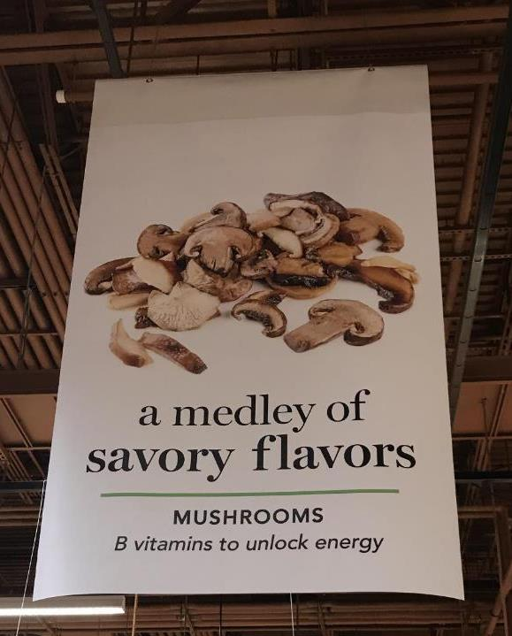
59%
Of consumers purchase specific fruits and vegetables because they associate them with specific health benefits
Link specific nutrients of various fruits and vegetables to related health benefits for the highest consumer impact.
The in-store banner example to the right links the feature (B vitamins) to the benefit (unlocking energy) — providing consumers with yet another reason to buy mushrooms.
Source: FMI, The Power of Produce 2022
Notes:
LinkedIn text
#Fruit and #vegetables have a natural health halo but #grocery retail has a great opportunity to highlight specific benefits on top of the overall healthful image. Many #produce labels and in-store signs highlight features such as high in Vitamin C or Potassium-rich. This is a the all important first step, but there is room for more. Not all consumers will know the health benefits associated with specific nutrients. @Wegmans in the picture below does a great job leveraging mushrooms to tie the feature (B vitamins) to the benefit (unlocking energy). Signage like this helps more consumers make educated decisions about food choices without having to do a lot of homework pre-trip.

Slide 6
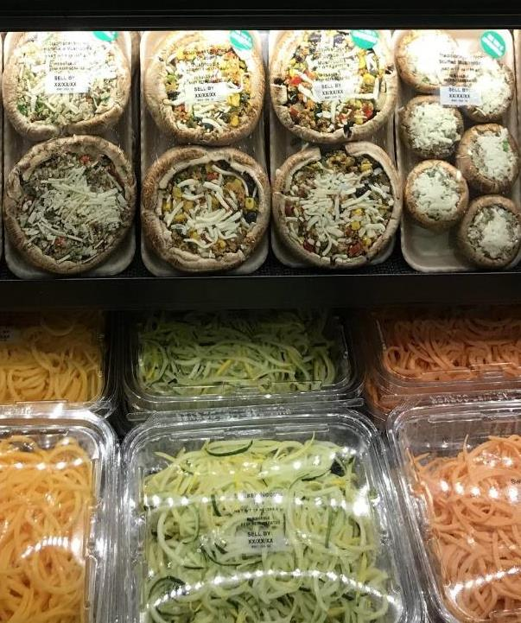
73%
Of consumers occasionally opt for plant protein instead of meat/poultry
Vegetables are the only item that can be the carb, the protein and the veg. Two-thirds of shoppers occasionally replace items like rice or pasta with spiralized or riced veggies. And 73% occasionally replace meat/poultry with a plant-based item. The most popular protein alternatives are: 44% beans/peas/lentils
41% leafy greens
36% mushrooms
Source: Power of Produce 2022
Notes:
LinkedIn text
Consumers have become much more fluid in their meal making. The idea of a traditional carb, meat as center of the plate and a vegetable on the side as the norm in meal making are long over. According to the 2022 Power of Produce by @The Food Industry Association, two-thirds of consumers occasionally replace a traditional carb such as pasta or rice with spiralized or riced vegetables. For instance, spiralized zucchini or squash can replace spaghetti noodles. And riced cauliflower can replace rice. The same thing happens for protein. According to the study, 73% of consumers occasionally replace meat or poultry with a plant-based items that contains protein. Beans are the most common example, mentioned by 44%, followed by leafy greens (41%) and mushrooms (36%).
If you think about it, #vegetables as the only item on the planet that can be the vegetable, the starch/carb and the protein. #Mushrooms are equally versatile and that makes us pretty special too.

Slide 7
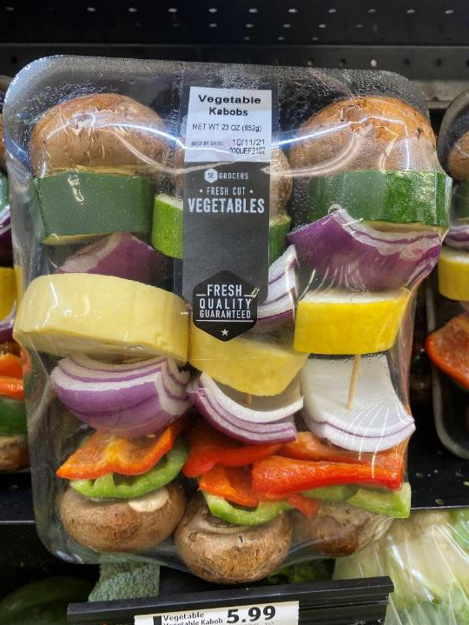
$4.9 billion
Consumers spending on outside cooking appliances, including grills, smokers and accessories
The NPD Group found that cooking outside has become a go-to activity amid the pandemic. More than 14 million grills and smokers were sold between April 2020 and February 2021.
Consumers have turned pandemic-driven boredom into an opportunity to experiment with cooking and vegetable kabobs with mushrooms are a great way to bring flavor and variety.
Source: The NPD Group, Enhanced Retail Tracking Service, April 2021
Notes:
Source: https://www.npd.com/news/press-releases/2021/consumers-take-grilling-and-outdoor-cooking-to-the-next-level-reports-npd/
LinkedIn text:
With meals becoming much more home-centric during the pandemic, Americans got bored with their stoves and ovens and invested massively into air fryers, Instant Pots, grills, smokers and more. According to @The NPD Group, consumers spent $4.9 billion on outside cooking appliance in the first pandemic year. This includes more than 14 million grills and smokers. #Vegetable kabobs are a great way to feature a wide variety of different veggies and #mushrooms while making it easy on the consumer to enjoy something different. While grilling season traditionally started on Memorial Day and ran through Labor Day, grilling is now a year-round activity — creating great additional usage occasions for mushrooms.

Slide 8
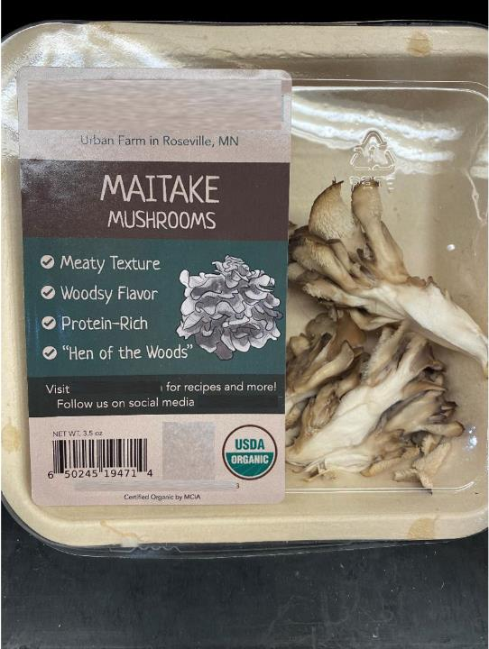
56%
Want to see their produce department carry a wider variety of locally-grown items
Consumers, especially Boomers, like the idea of keeping dollars in the community and helping local growers. At the same time, consumers’ definition of local varies widely, often depending on where they live in the country:
23% a certain radius
30% state lines
16% same city or town
18% grown in the USA
Source: FMI, Power of Produce 2022
Notes:
LinkedIn text:
Claims have been a growth driver across departments, including produce. For fresh fruit and vegetables, the most powerful production-related claim is locally-grown. According to the 2022 Power of Produce, 56% of consumers want to see their produce departments carry a wider variety of locally-grown items — ahead of claims such as organic and non-GMO. Consumers like the idea of keeping dollars in the community, their food traveling short distances and, of course, supporting local farmers. But local may not be as local as you think. According to the study, 23% think of local as being a certain radius from where they live or shop; 30% think of state lines; 16% think of the same city or town; and 18% simply think of it as being grown in the United States. That means many items in the produce department qualify in the eyes of the consumer, though many grocery retailers have succinct ways of how they define local.
The example below does a great job highlighting the locally-grown nature of the Maitake Mushrooms to shoppers at @Lunds & Byerly’s in Minneapolis, MN. Referencing the urban farm in Roseville, MN and the state outline below allows shoppers to vote with their wallets as it relates to locally-grown.
USDA questions:
Do we need to block out the brand name?
Do we need to block out the social media handle?
If we cannot use this one, please scoot it to the side and there is a Dutch one on there with a little Dutch flag. Could we use this one?

Slide 9
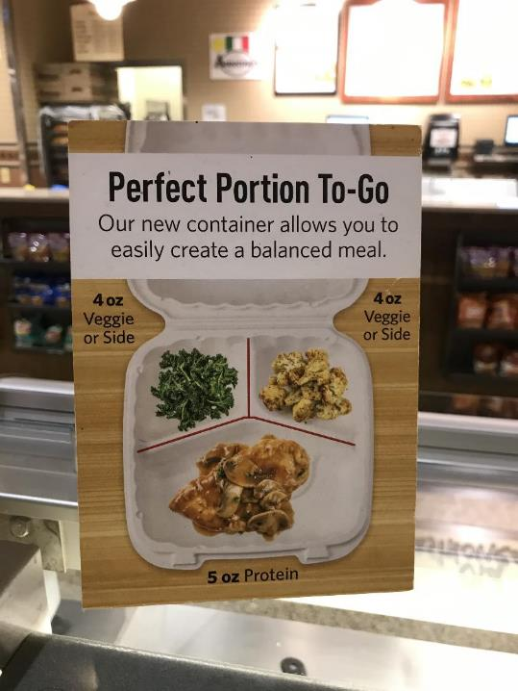
64%
Of consumers look to make better-for-me/my family meat/poultry decisions
Most consumers believe in balance not elimination as it relates to animal protein, with only 6% of Americans adhering to a vegetarian or vegan diet. Instead, 64% look to better-for-me choices and portion control plays a big role.
Here’s a great example that educates people on perfect portions, 5 ounces of protein, and highlighting mushrooms as a way to complement animal protein for even better balance.
Source: Power of Meat 2022
Notes:
According to the Power of Meat 2022, eating a #vegetarian or #vegan diet remains uncommon at just 6% of Americans. But 64% of Americans do look to make better choices as it relates to meat and poultry. This may be leaner cuts or kinds of meat, but smaller portions or avoiding second helpings is a big part of their strategy as well. Where a lot of Americans struggle is understanding what constitutes a recommended portion. In salad and hot/cold food bars, grocery retailers have a real opportunity to offer a helping hand and @Wegmans is doing just that.
Featured on top of their hot/cold food bar is a sign that shows why Wegmans has opted for a new container that is divided into three compartments: helping consumers easily create balanced meals. The sign suggests a 5 ounce portion of protein and showcases #mushrooms as a way to complement #meat and #poultry for even better balance.

Slide 10
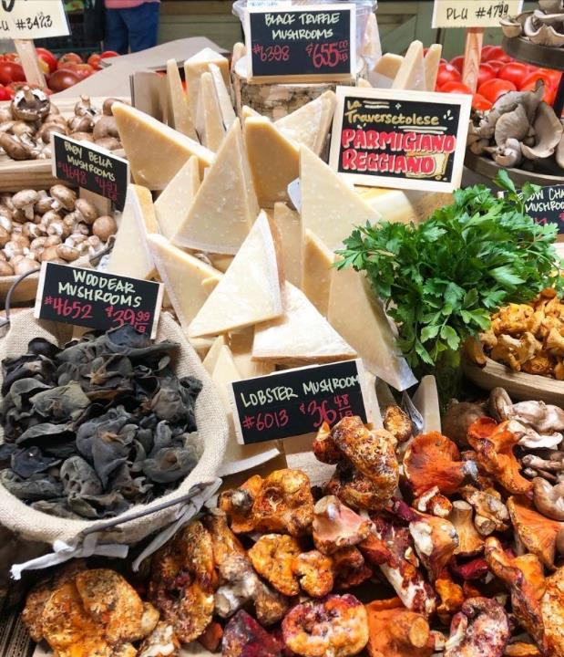
62%
Of consumers looking to save on eating out want to recreate restaurant meals at home
Food inflation is at its highest point in more than 40 years and 61% of consumers look to cut back on their food spending by doing more of their own cooking.
Of these consumers, 62% want to recreate restaurant meals at home. Central Market in Texas helps its shoppers make these meals extra special, with exotic mushrooms and fresh parmesan cheese for that extra, restaurant touch!
Source: Power of Meat 2022 | Inflation: Bureau of Labor Statistics

Slide 11
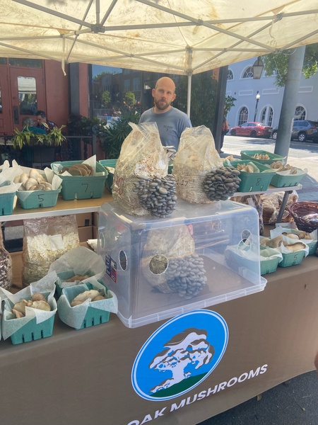
60%
Of consumers purchase fresh produce at farmers’ markets
While supermarkets, club and mass capture the vast majority of fresh produce purchases, dollars do escape to many alternative channels, led by farmers’ markets. The 60% of consumers who buy there, believe the produce is fresher (61%), of better quality (58%) and want to show support for local farmers (56%).
Most retailers offer fresh, high quality and locally-sourced items too, which begs the question: is there room for better storytelling?
Source: Power of Produce 2022

Slide 12
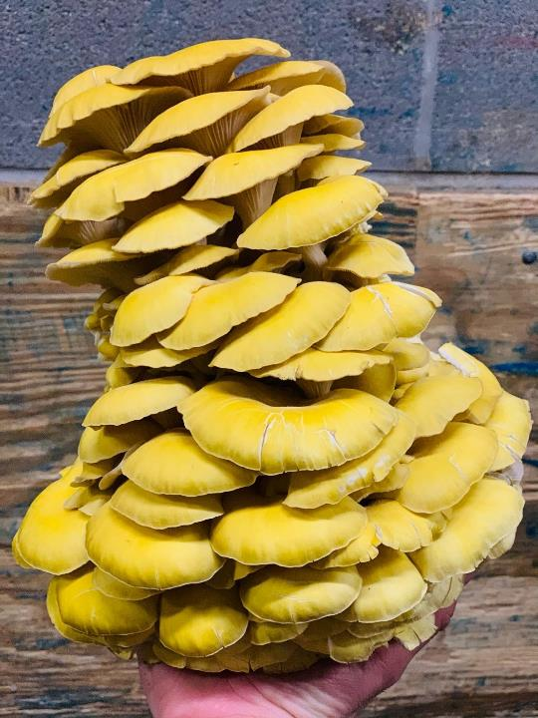
46%
Of consumers can be encouraged to make unplanned produce purchases by eye-catching displays
Amid high inflation, 82% of consumers plan and list out produce purchases pre-trip. This is up from 75% in 2017.
At the same time, the visual beauty of fresh produce prompts many consumers to make impulse purchases: 46% of consumers say an eye-catching display can encourage them to make an unplanned produce purchase.
Source: Power of Produce 2022

Slide 13
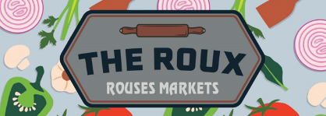
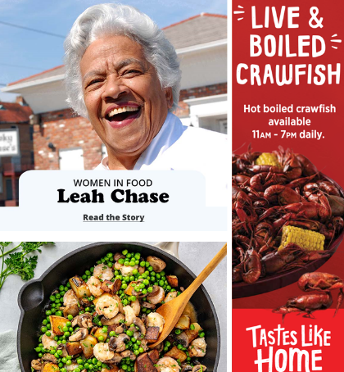
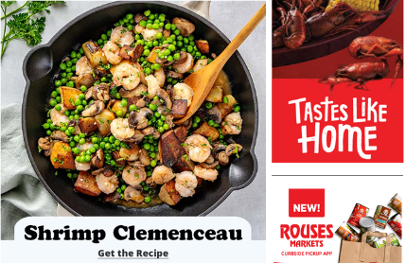
+31%
2021 fresh seafood dollar growth vs. 2019 pre-pandemic sales
Seafood, with annual sales of $7.1 billion in 2021, has been a pandemic powerhouse. Seafood and mushrooms are a great match — both benefitting from a strong health halo. Add a local celebrity into the mix and we have a winning trifecta.
Rouses Markets in the New Orleans, LA area, recently highlighted Leah Chase as a top woman in food. They shared her recipe for Shrimp Clemenceau — a secret weapon in Leah’s arsenal. The simple sauté, featuring mushrooms, crispy Brabant potatoes, garlic and canned green peas has always been a mainstay at Dooky Chase Restaurant, the place she called home for more than fifty years.
Source: IRI, Integrated Fresh, 52 weeks ending 12/26/2021

Slide 14
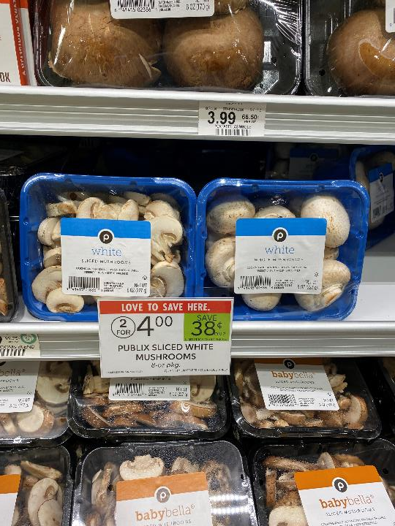
15.7%
Share of mushrooms pounds sold on promotion (any merch)
While the fourth and first quarters of the year are the biggest in terms of sales, mushrooms are popular year-round.
Base sales drive the bulk of mushroom sales. About 16% of mushroom pounds are sold while on promotion — whether a display, ad feature, price discount or a combination thereof. This compares to 35.2% for fruit and 20.8% for total vegetables.
Source: IRI, Integrated Fresh, MULO, 52 weeks ending 12/26/2021

Slide 15
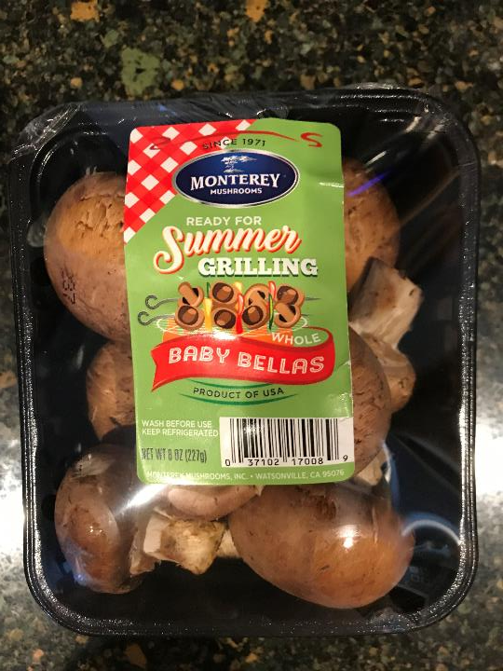
9.2x
Consumers grill an average of 9.2 times per month, especially during the summer holidays
Defined as the weeks from Memorial Day to Labor, the annual grilling season is upon us. Grilling season boosts meat sales, in particular ground beef and steaks.
This is a great opportunity for mushrooms:
Blended burgers
Steak with mushrooms
Veggie kabobs with mushrooms as the side
Source: NCBA, Summer Grilling and Consumer Comfort Survey, March-April 2021

Slide 16
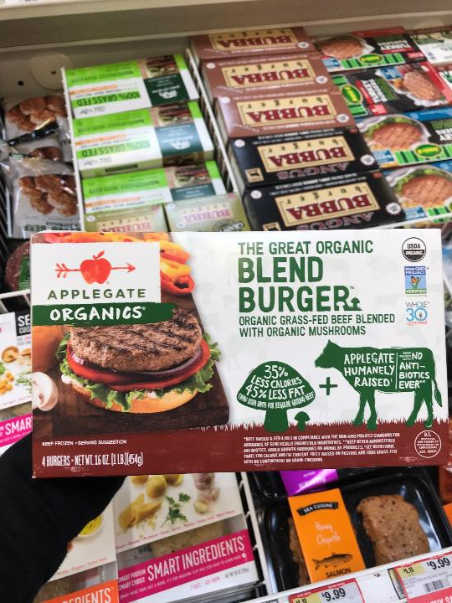
65%
Of consumers eat blended items
The Power of Meat 2022 found that 65% of American consumers eat meat blended with vegetables and/or mushrooms occasionally or frequently.
This includes people creating their own blends as well as an ever-growing variety of blended solutions at retail, in the frozen food aisle, meat case and in produce — with ready-to-blend diced mushroom solutions.
Source: The Power of Meat 2022

Slide 17
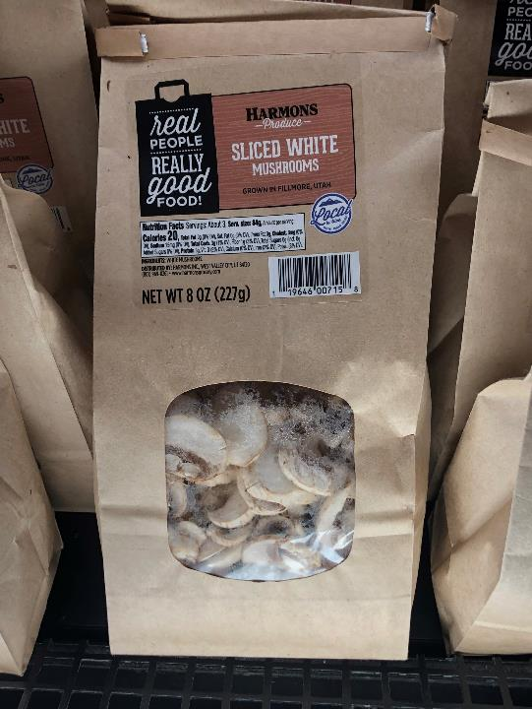
72%
Of consumers are concerned about the amount of plastic and packaging waste when buying fresh produce
The cross-population concern over produce packaging waste translates into 52% of consumers wanting to see the use of environmentally-friendly packaging. At the same time, consumers feel functionality, including adequately protecting the product, should weigh equally.
Here’s a great example by Harmons in Utah selling mushrooms in an entirely different way.
Source: Southeast Produce Council and 210 Analytics, What’s New 2021

Slide 18
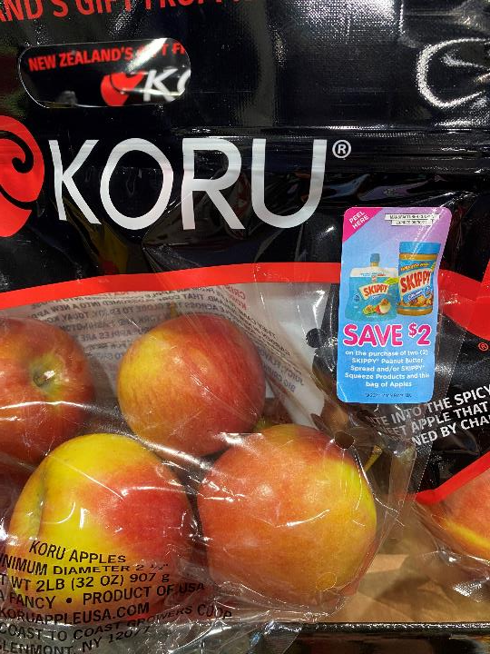
64%
Of consumers believe having produce items merchandised throughout the store is somewhat or very useful
Cross-merchandising and secondary displays are popular with consumers and deliver big for retailers. But the challenge is labor hours. Koru apples found that many customers like dipping apple slices into peanut butter and cleverly used an on-pack label to remind and reward people in store.
Mushroom’s versatility is legendary — from pasta sauce to steaks to pizza — and reminding/rewarding shoppers can bring home the incremental purchase.
Source: Power of Produce 2020

Slide 19
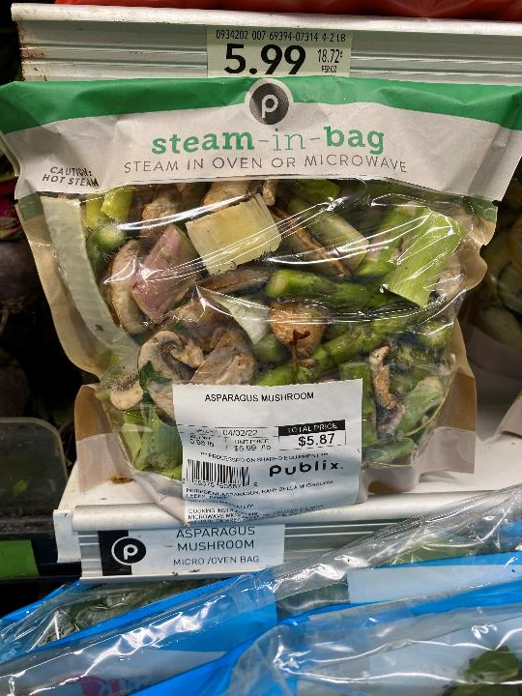
+11.2%
Value-added produce $ growth
Value-added produce sales reached $10.2 billion, which is 14.4% of total produce sales. That is up from 12.4% in 2020 due to above-average growth for convenience-focused, time-saving items.
A great example is this asparagus mushroom mix by Publix. Offered in a “steam-in-bag” packaging that is ready to go into the oven or microwave this addresses easy preparation and cleanup!
Source: IRI, Integrated Fresh, MULO, 52 weeks ending 10/31/2021

Slide 20
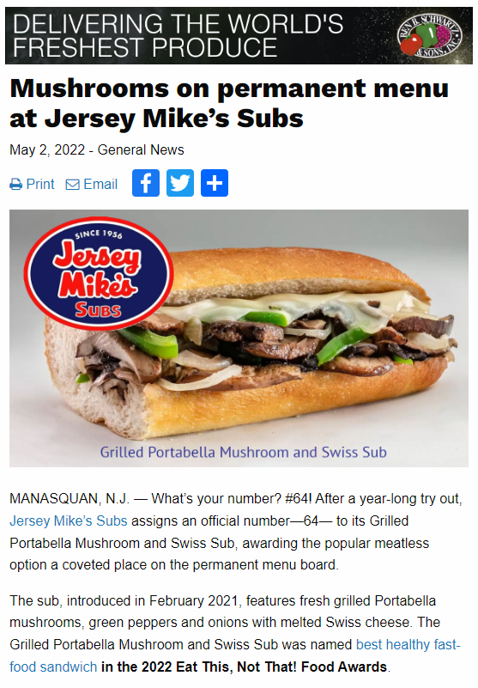
#64
After a year-long try out, Jersey Mike’s Subs assigned an official menu number, 64, to its Grilled Portabella Mushroom and Swiss Sub
Using grilled portabella mushrooms, green peppers and onions with melted Swiss cheese, it was named the best healthy fast-food sandwich in the 2022 Eat This, Not That! Food Awards
Source: https://www.producebluebook.com/2022/05/02/mushrooms-on-permanent-menu-at-jersey-mikes-subs/#
Source: https://www.eatthis.com/news-best-healthy-fast-food-2022-food-awards/

Slide 21
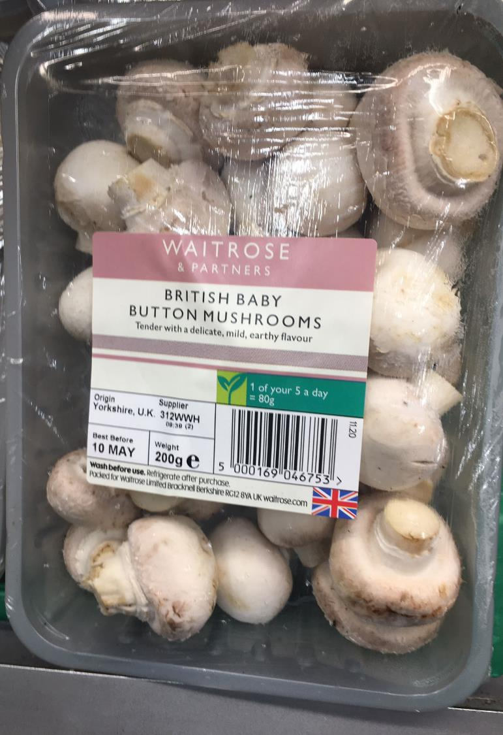
52%
Of Americans are interested in knowing where their fresh produce was grown
Consumers increasingly want to know the who, what, where and how behind the food they buy. When purchasing fresh produce, 52% are interested in knowing the country in which the produce was grown.
Waitrose in the United Kingdom merchandises their fresh mushrooms as “British baby button mushrooms” and the Union Jack reinforces the country of origin angle.
Source: SEPC and 210 Analytics, What’s New 2021

Slide 22
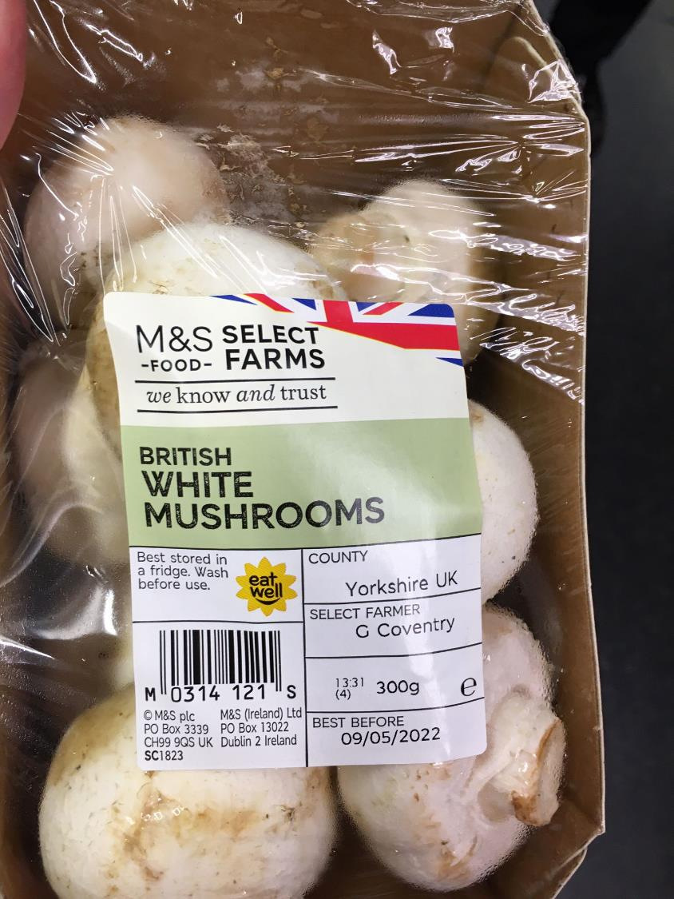
46%
Of Americans are interested in knowing who grew the fresh produce
Consumers increasingly want to know the who, what, where and how behind the food they buy. When purchasing fresh produce, 46% of shoppers like to know more about the farmer/grower.
A great example of providing such transparency is Marks & Spencer in the United Kingdom, listing both the county and grower’s name on the front-of-pack label.
Source: SEPC and 210 Analytics; What’s New 2021

Slide 23
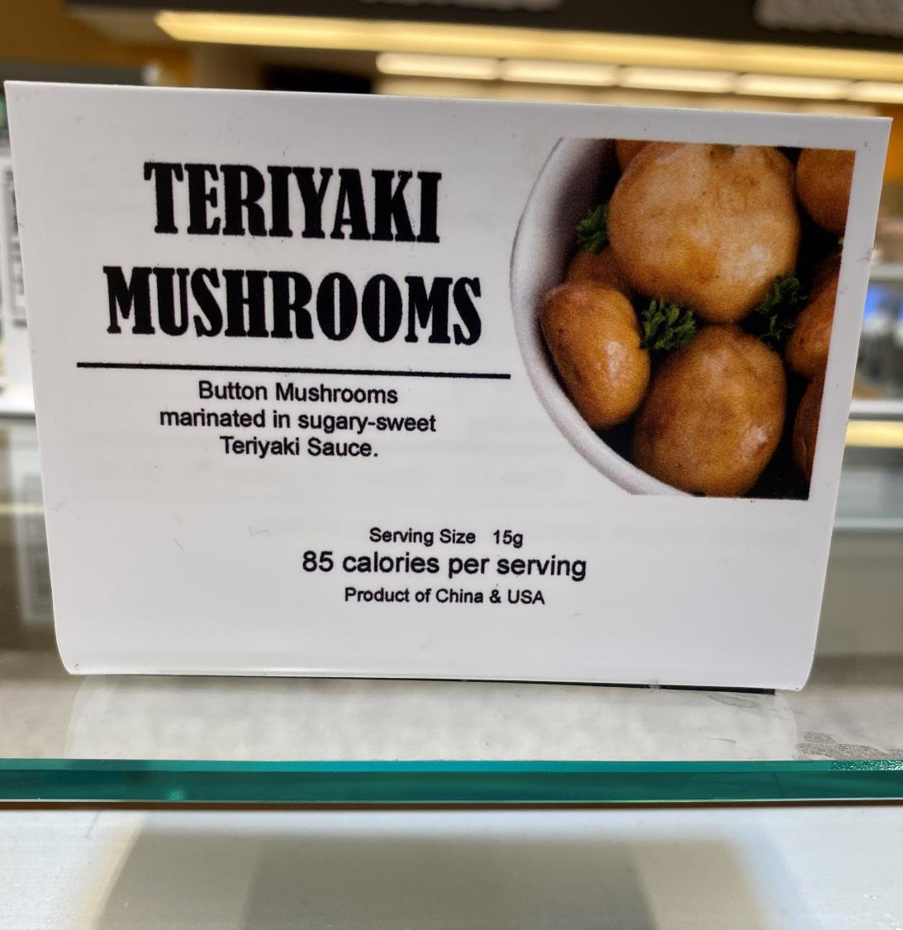
2/3
Consumers occasionally or frequently purchase from salad, olive or cold/hot food bars at the grocery store
Self-serve is back and consumers are happy for it. Around two-thirds of grocery shoppers occasionally or frequently purchase from:
61% salad bars
65% olive bars
66% hot/cold food self-serve buffets
Source: FMI, Power of Retail Foodservice 2021

Slide 24
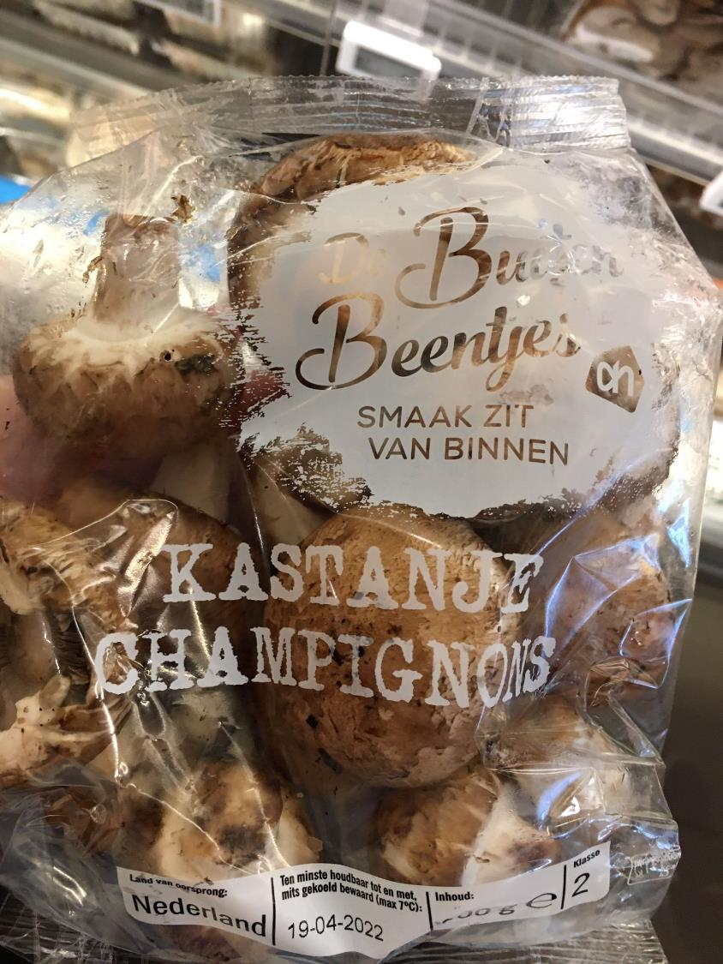
35%
Vegetable and fruit share of total food waste at Dutch supermarkets
Albert Heijn in the Netherlands set a goal of halving their food waste by 2030. Across its chains, 1.7% of food pounds never make it to the consumer and fresh produce is the biggest contributor. One of its initiatives to curb food waste is “buiten beentjes,” meaning “misfits.” The program offers a variety of fruit and vegetables with a suboptimal look at a discount. The program’s tagline “smaak zit van binnen,” meaning “taste is on the inside” stresses that the items taste just as good, if not better.
Source: Centraal Bureau Levensmiddelenhandel (CBL) / Albert Heijn

Slide 25
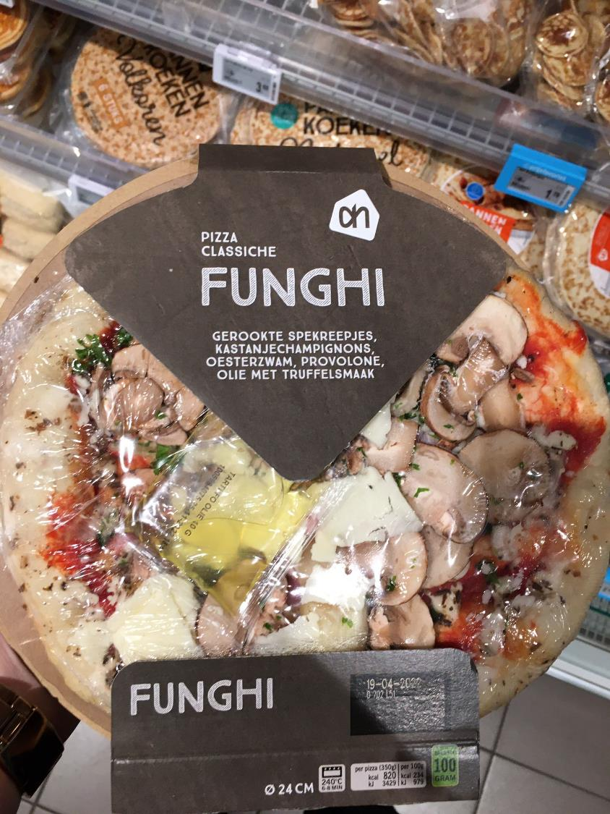
#3
Mushrooms are America’s third-favorite pizza topping and top produce item
While the opinions on pineapple remain divided, 31% of Americans voted for mushrooms as their favorite pizza topping. Pepperoni took 53% of the vote and sausage edged out mushrooms, at 34%.
Albert Heijn’s Funghi pizza takes the mushroom experience to a whole new culinary level with crimini and oyster mushrooms, complemented with smoked bacon and truffle oil.
Source: YouGov America, February 2019

Slide 26
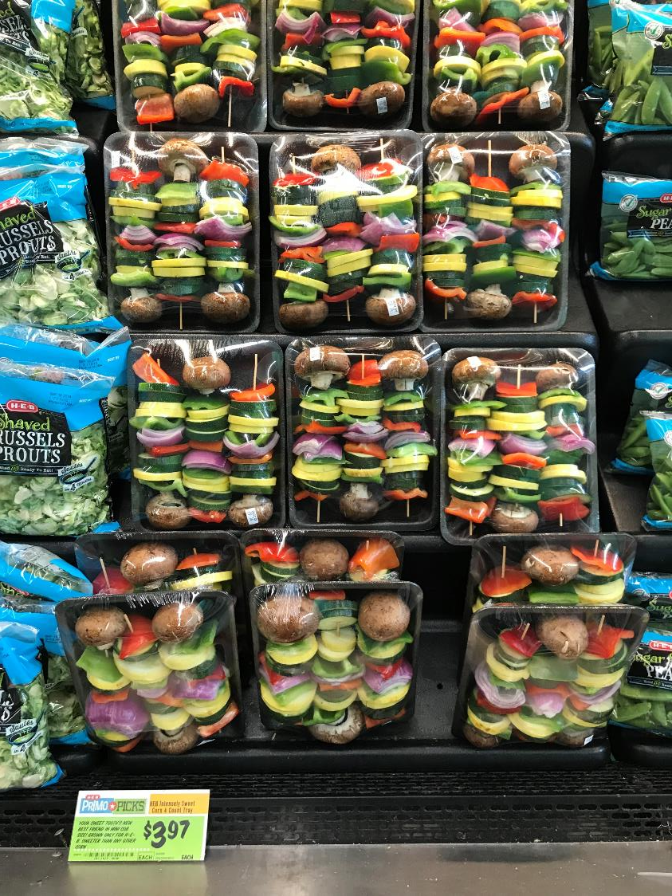
57%
Of consumers plan to entertain at home, whether parties or small gatherings
Life has been home-centric since the start of the pandemic, but Americans have gotten back to seeing friends and family, especially in the summer months. IRI found that 57% of consumers are planning to entertain at home this summer, of whom 13% plan to do so more than last year.
Mushrooms are the ultimate get-together food, from stuffed mushroom appetizers to veggie kabobs on the grill…they never disappoint!
Source: IRI, Primary Shopper Survey May 2022, n=1024

Slide 27
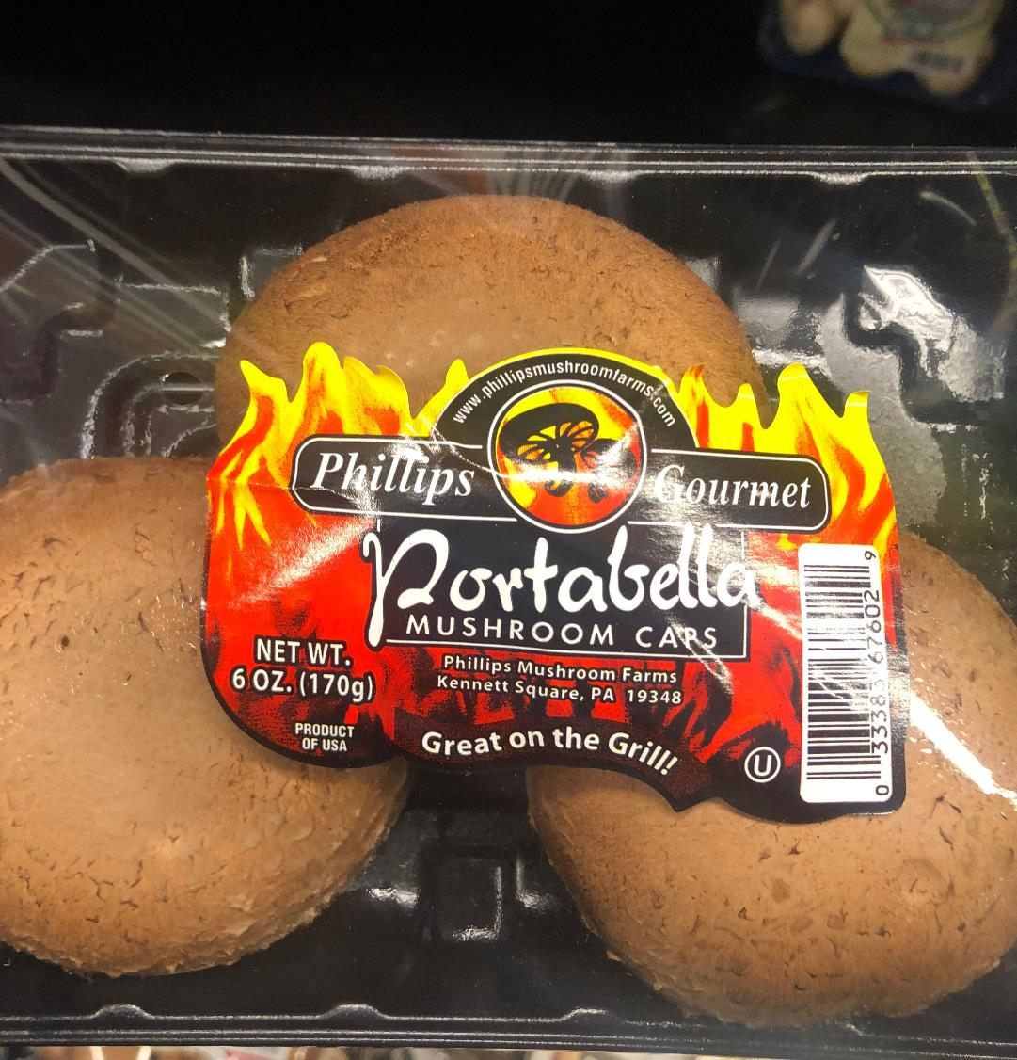
71%
Of consumers expect they will grill or cook meals outdoors as much or more this summer vs. last
Many Americans expect they will fire up the grill more often this summer. And mushrooms, are a must, of course! Whether staycations or entertaining, the reasons for grilling more are plentiful :
48% Plan to do more outdoor entertaining
37% Like trying new grilling recipes
25% Improved their patio/deck
19% Have a new grill
Source: IRI, Primary Shopper Survey May 2022, n=1024

Slide 28
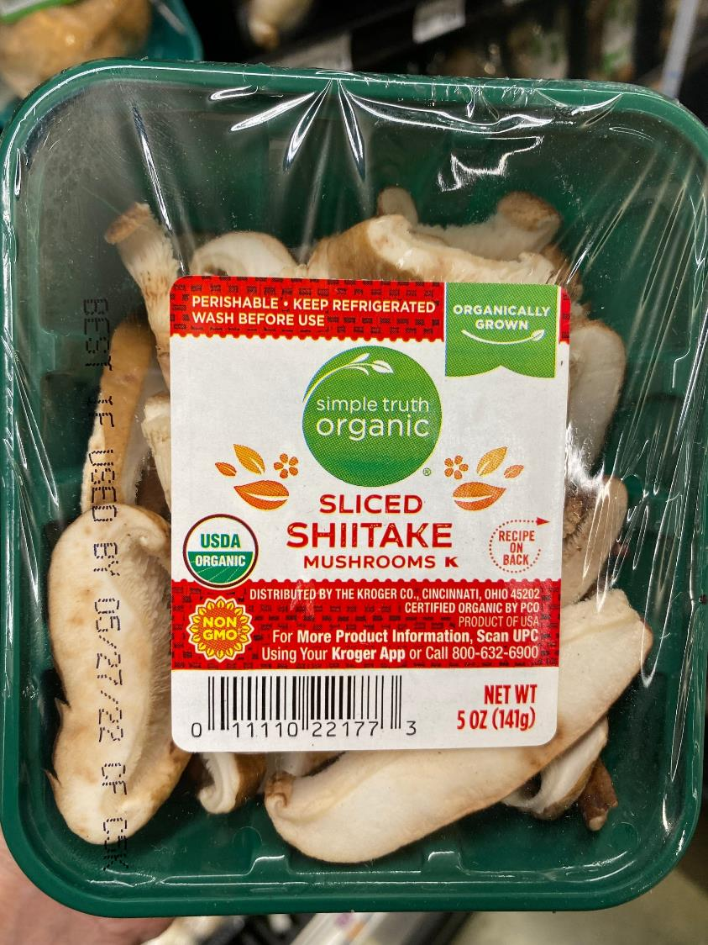
34%
Of shoppers say non-GMO references influence their fresh produce purchases
Half of U.S. shoppers say knowing how their produce was grown influences what they purchase. More specifically, 34% say non-GMO references matter. Non-GMO means most to Millennials (41%) and Gen X (35%) and is also very important to organic shoppers.
In response, The Kroger Company calls out non-GMO on their sliced shiitake organic mushrooms, along with the USDA organic logo and recipes on the back of the label.
Source: FMI, Power of Produce 2022

Slide 29
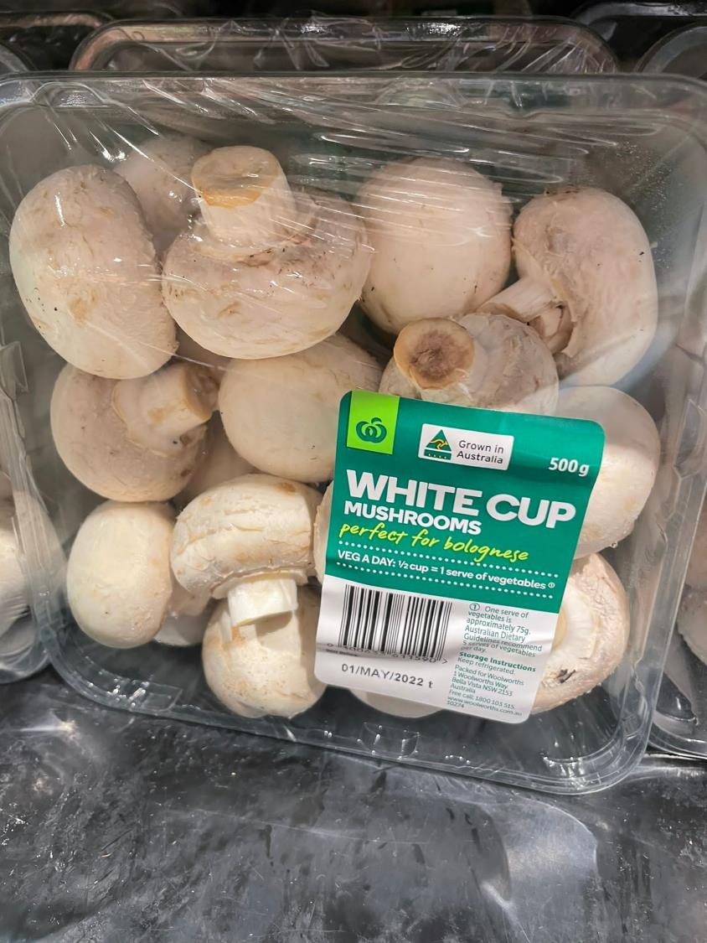
44%
of consumers do not believe there is enough information on what constitutes a serving of fresh produce
Access to more nutrition information remains an opportunity for the fresh produce industry: 44% of Americans cannot easily find what constitutes a portion size in fresh produce when trying to consume the recommended daily amounts.
Woolworths Australia gives advice on mushroom servings in a very practical way:
VEG A DAY: ½ cup = 1 serve of vegetables
Source: FMI, Power of Produce 2022

Slide 30
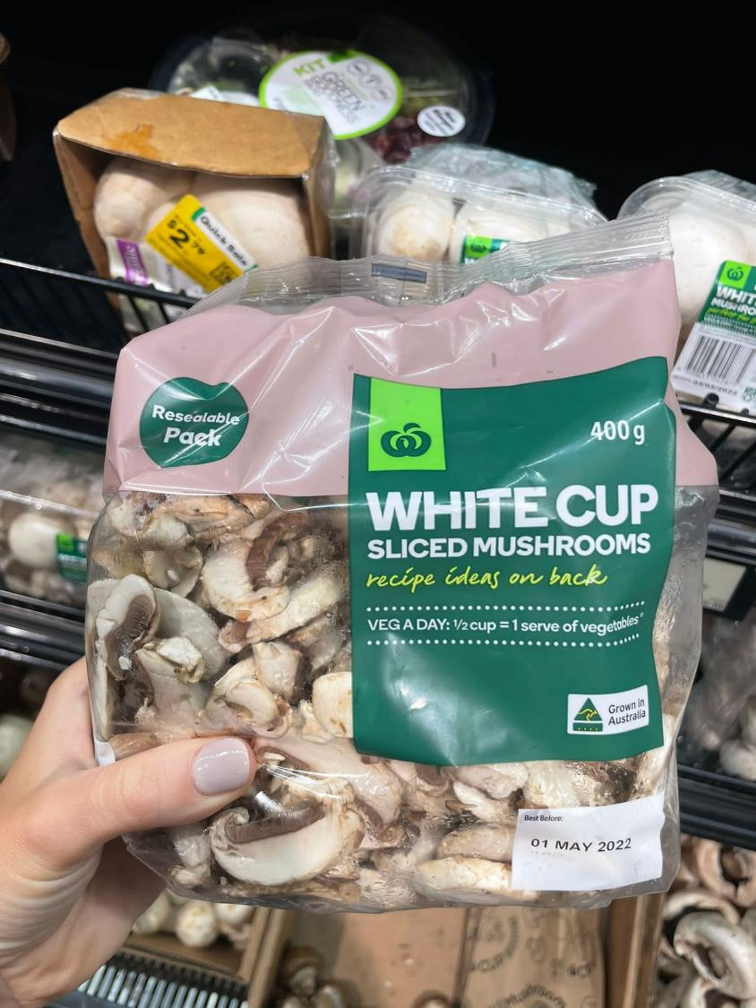
46%
Of shoppers would like to see more resealable produce packages
Consumers recognize packaging plays a role in shelf life, food safety, in-store conditions, product information and portability. But many would also like to see some changes made, including 46% who would like to see more resealable packages being used in fresh produce.
One great example is to your right, by Woolworths Australia that sells white sliced mushrooms in a resealable bag, along with portion size information and recipes.
Source: FMI, Power of Produce 2020

Slide 31
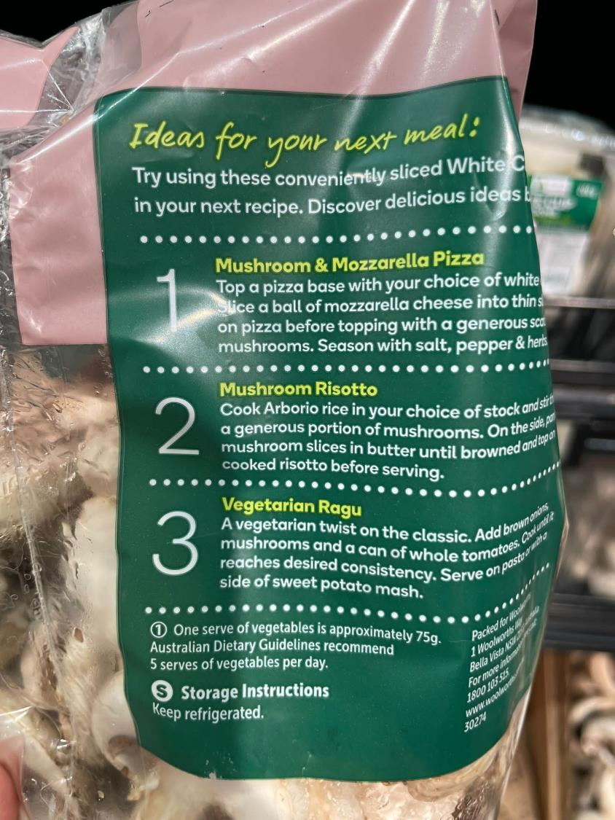
27%
Of consumers can be encouraged to make unplanned fresh produce purchases through recipes
Deciding what’s for dinner can take just as much effort as the meal preparation itself. On-pack recipes can help solve the dinner dilemma and land a sale.
Woolworths Australia provides “Ideas for your next meal” on their sliced mushroom packaging. The recipes offer something for everyone, from adding them as a pizza topping, making mushroom risotto or a vegetarian mushroom ragu.
Source: FMI, Power of Produce 2022

Slide 32
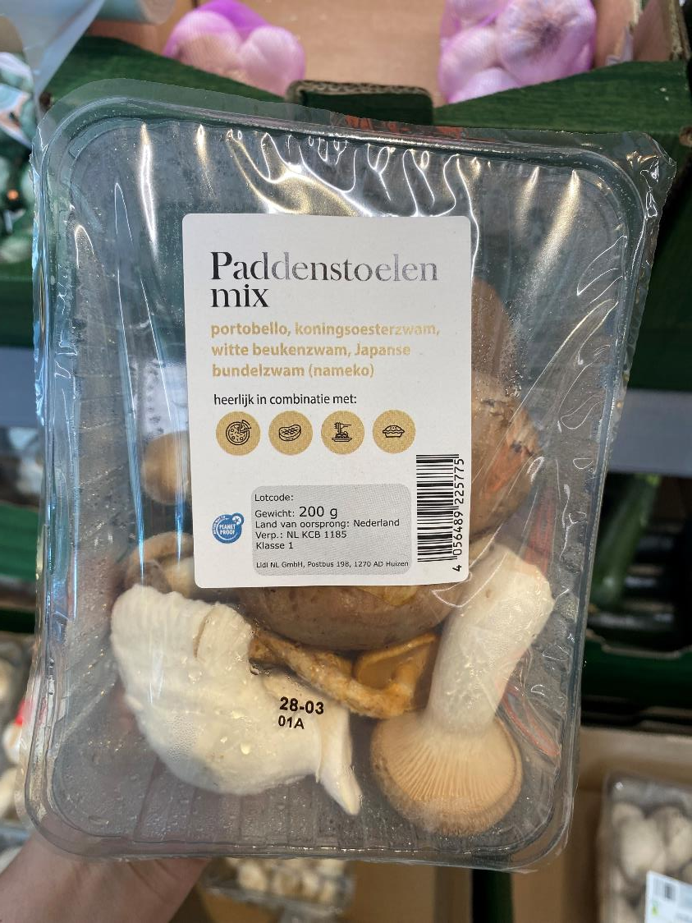
Versatility
Mushrooms are the number one listing on What’s For Dinner’s “10 Versatile Foods with Limitless Possibilities.” The article describes mushrooms as the fungi everyone wants at the party.
This mixed mushroom item from Lidl in the Netherlands does a great job reminding shoppers of mushrooms’ versatility. “Wonderful in combination with” followed by icons for:
Pizza
Steak/meat
Pasta
Casseroles
Source: https://whatsfordinner.com/kitchen-tips/10-versatile-foods-limitless-possibilities/

Slide 33
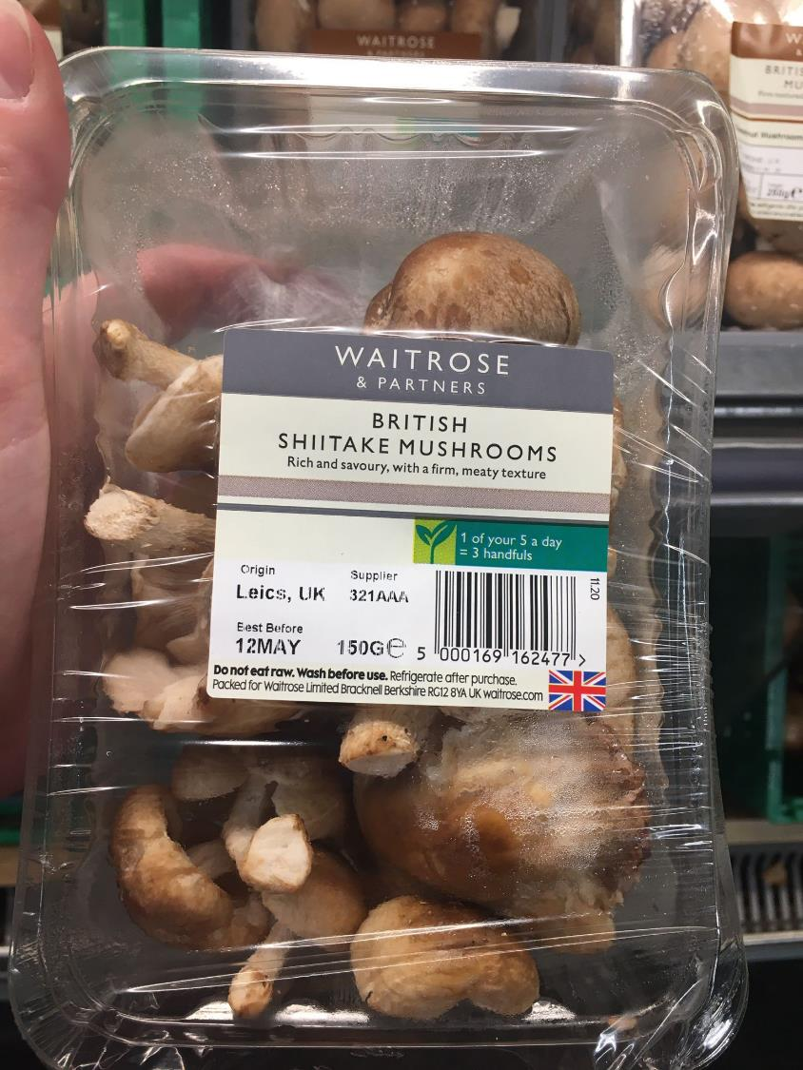
80%
Of consumers say the taste of foods and beverages impacts their purchase decisions.
Ahead of price, healthfulness, convenience and environmental sustainability, it is taste that has the greatest impact on consumers’ purchase decisions.
This mushroom package from Waitrose in the United Kingdom provides shoppers with an idea of what to expect “Rich and savoury, with a firm, meaty texture.” These kinds of descriptions can help fuel food experimentation among consumers.
Source: International Food Information Council. 2022 Food and Health Survey. 18 May 2022. https://foodinsight.org/2022-food-and-health-survey/

Slide 34
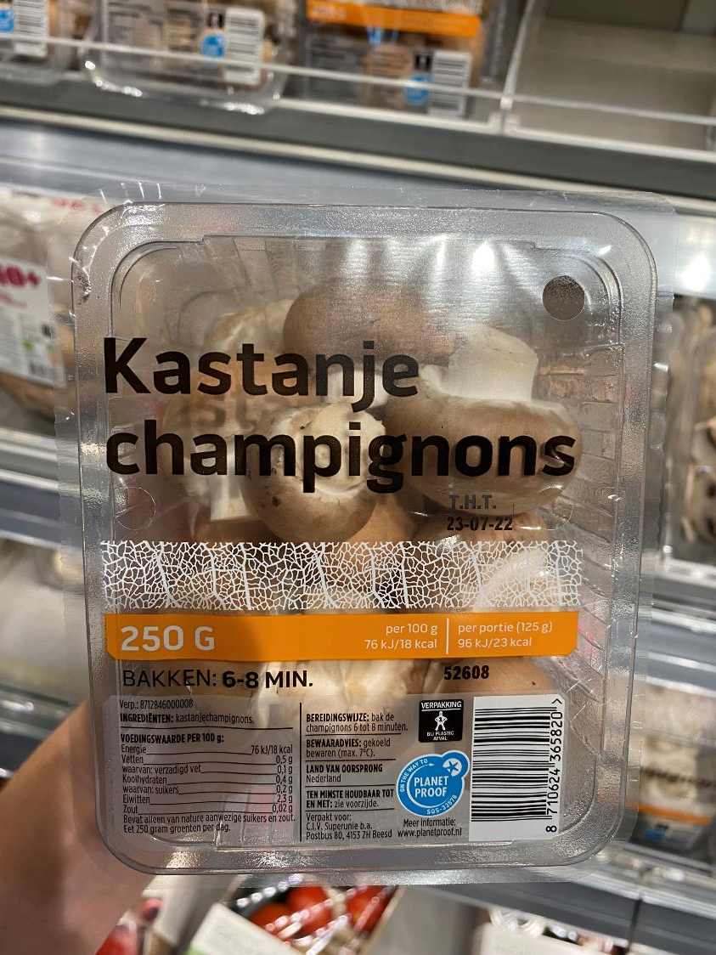
66%
Of consumers give thought to whether foods and beverages are produced in a sustainable way.
Younger consumers (ages 18-34) are much more likely to consider sustainability, at 79%, than shoppes ages 65+ (53%)
These mushrooms by Dekamarkt in the Netherlands provide consumers with clear instructions on how to discard the packaging and are part of a program, called “On the Way to Planet Proof” – an independent quality label that proves that food and floriculture products are produced sustainably.
Source: International Food Information Council. 2022 Food and Health Survey. 18 May 2022. https://foodinsight.org/2022-food-and-health-survey/
www. Planetproof.eu

Slide 35
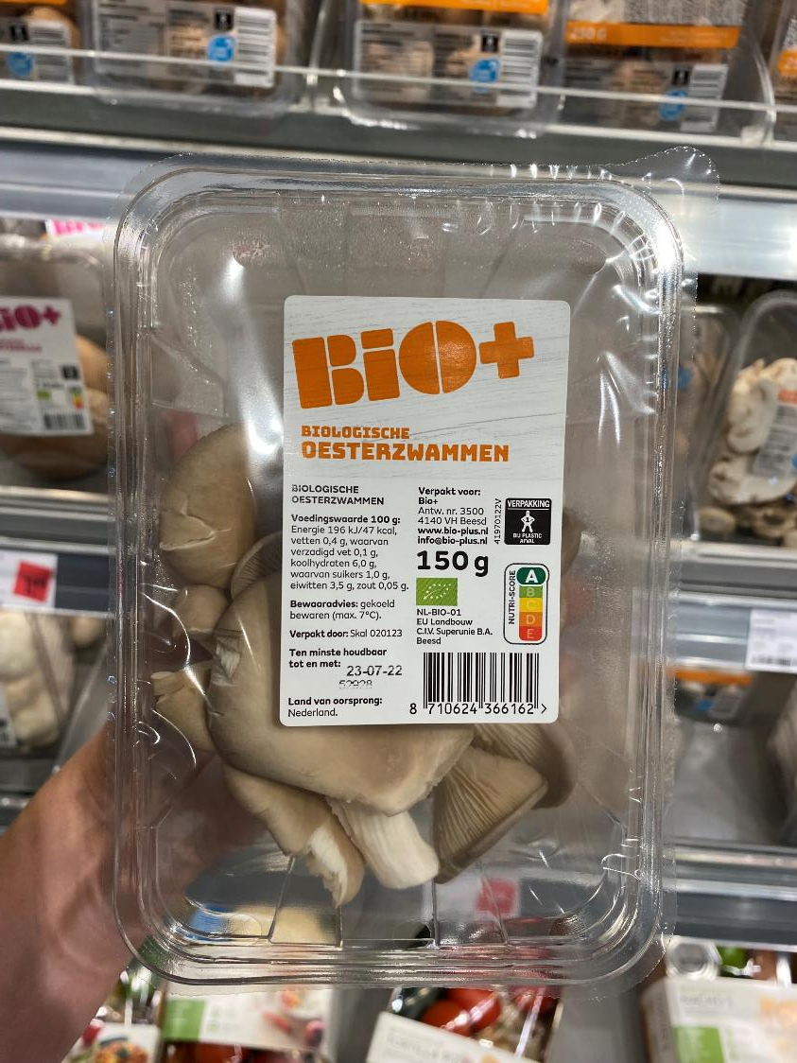
60%
Of consumers say healthfulness of foods and beverages impacts their purchase decisions
Information regarding foods to eat or avoid is obtained from a wide range of sources. Top resources are nutritionists and healthcare professionals and 31% rely on food companies or manufacturers.
This mushroom package from Dekamarkt in the Netherlands shows nutrition facts as well as the A (top) grade on the five-letter international Nutri-Score system that is used for food products across the store.
Source: International Food Information Council. 2022 Food and Health Survey. 18 May 2022. https://foodinsight.org/2022-food-and-health-survey/

Slide 36
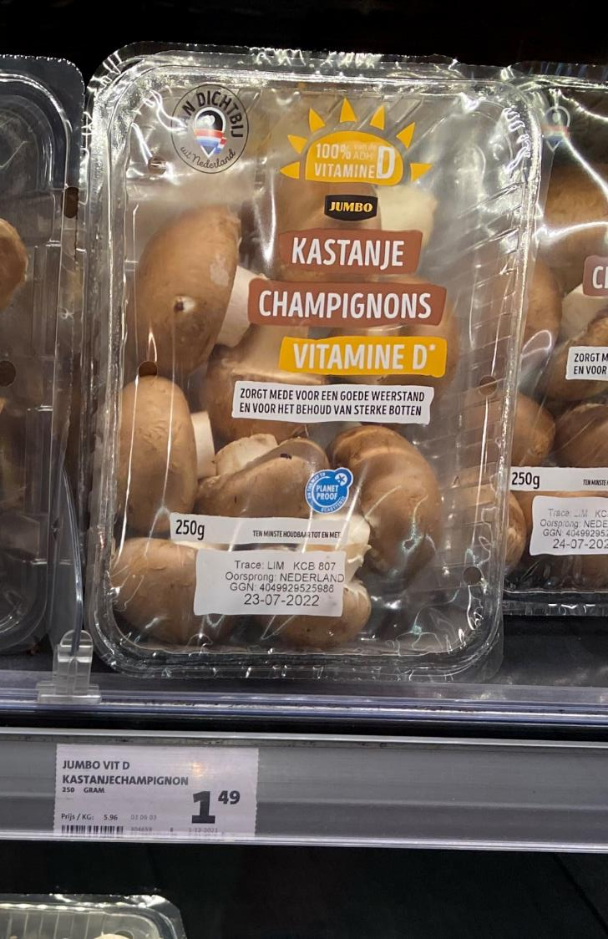
57%
Of consumers try to consume Vitamin D
Vegetables and fruits are the most consumed foods to address energy levels, weight loss, digestive health and heart health, according to the International Food Information Council. Consumers rank Vitamins C and D high on their list for addressing immune function/health.
These mushrooms by Jumbo Supermarkets in the Netherlands highlight their 100% contribution to the recommended daily value of Vitamin D in the diet. The packaging further explains “also prompts good immunity and maintaining good bone health.”
Source: International Food Information Council. 2022 Food and Health Survey. 18 May 2022. https://foodinsight.org/2022-food-and-health-survey/

Slide 37
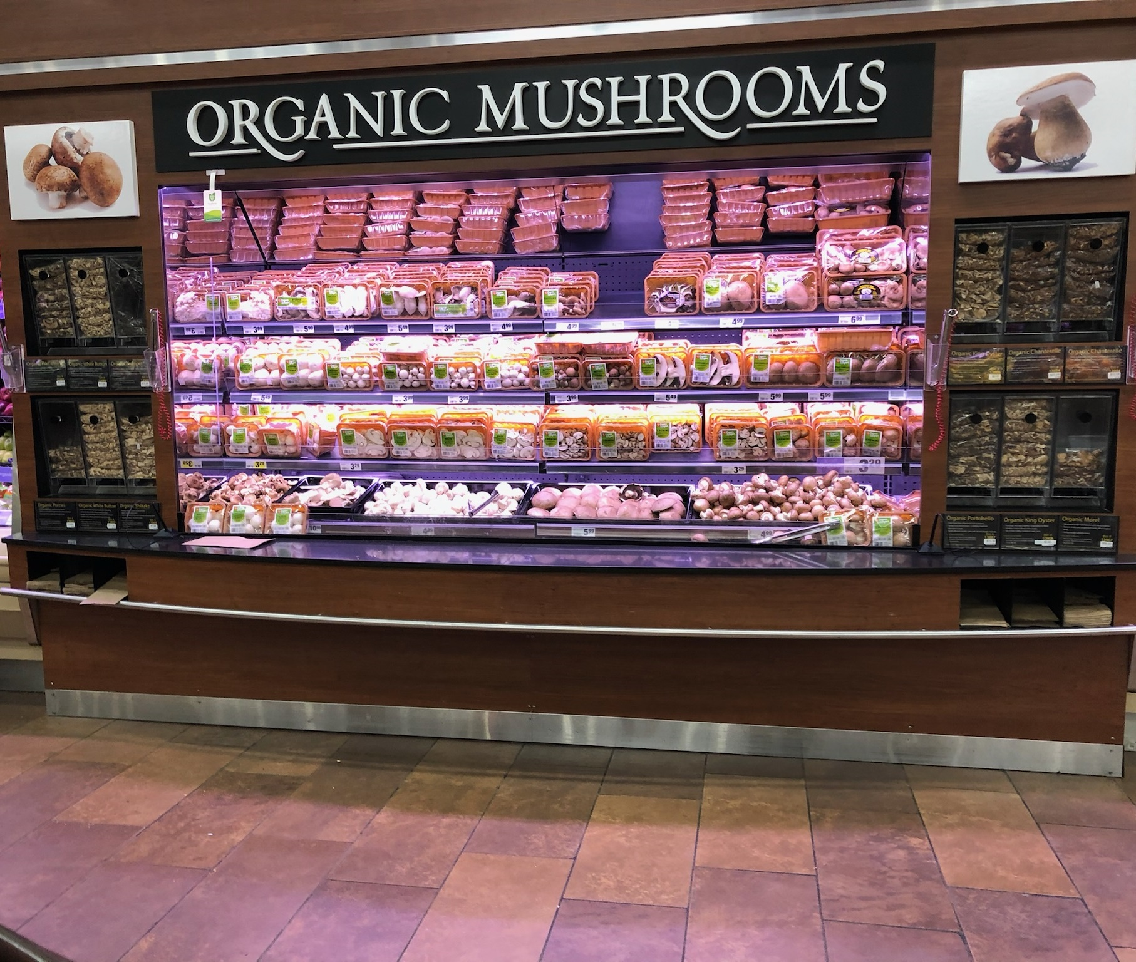
+1%
Organic mushroom sales YTD versus YA
While conventional mushrooms make up the bulk of sales, organic mushroom dollars sales are growing, especially in the specialty segment.
Organic specialty mushroom sales increased 33.7% YTD versus the same period year ago, driven by a strong performance in Shiitake.
Source: IRI, MULO, YTD through w.e. 8-7-2022

Slide 38
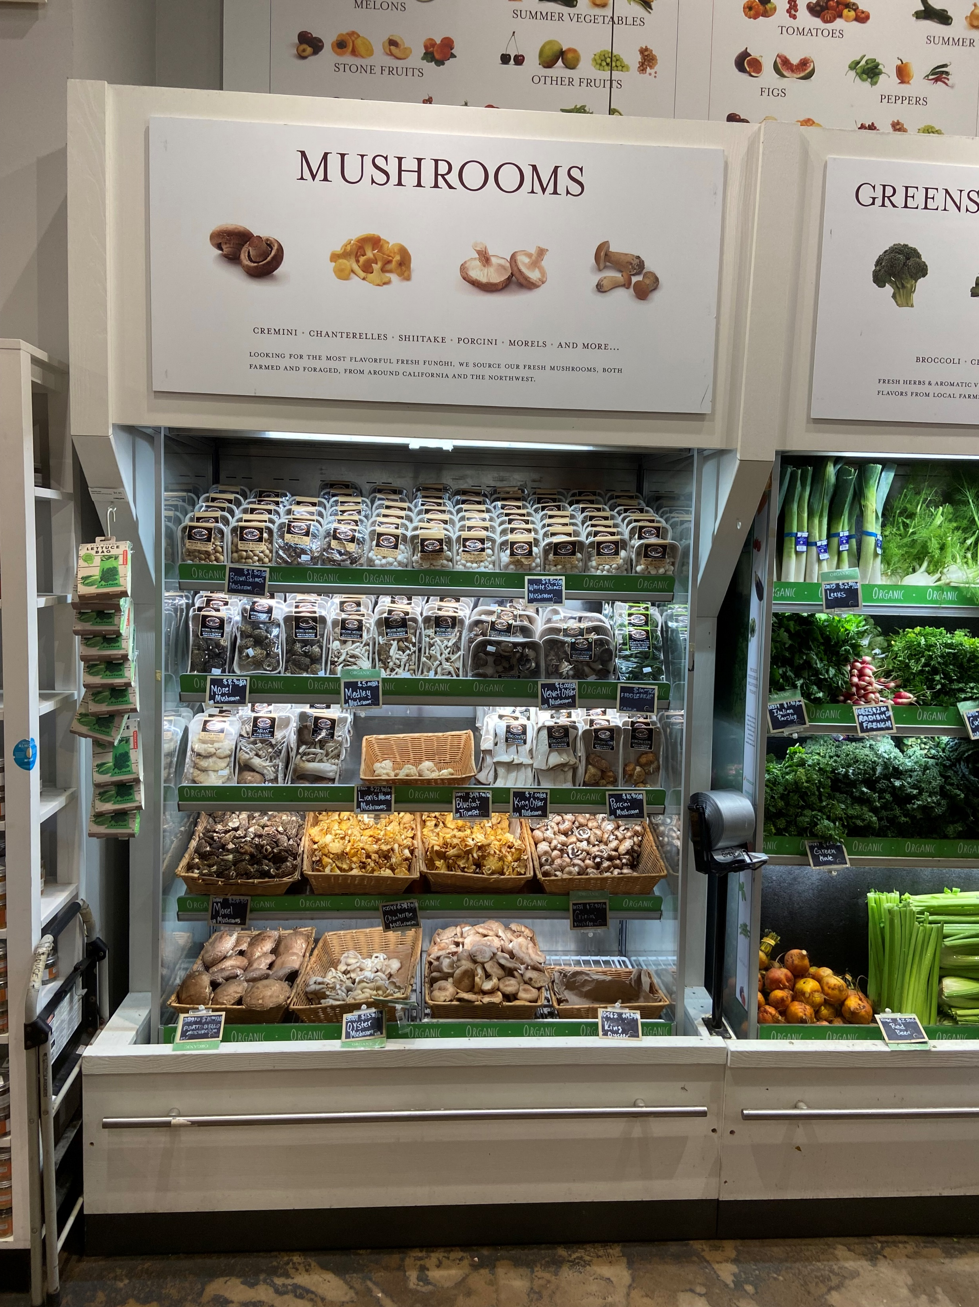
5%
Bulk mushroom’s share of total mushroom sales
With fewer retailers carrying bulk mushrooms, their share of dollars hovers around 5%. Retailers often leverage bulk to merchandise specialty mushrooms.
Bulk displays…
Can be of interest to drive trial as consumers can buy a limited amount to see if they are up for more
Can be useful for smaller households that may not need a full 8 or 16 ounces and want to prevent food waste
Source: IRI, Integrated Fresh, MULO, YTD weeks ending 8-7-2022

Slide 39
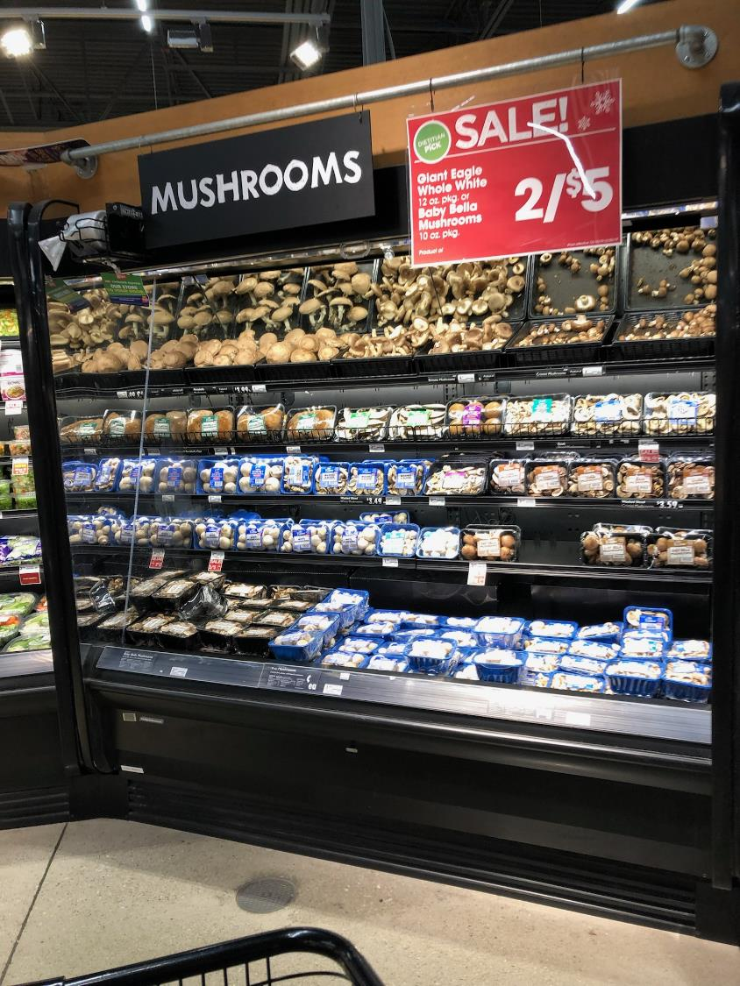
Dietitian pick
The COVID-19 pandemic drove many Americans to think more about their health — from general wellness to chronic disease management. Retail dietitians can be essential in helping Americans make healthier choices and ensuring focus is on evidence-based information that promotes health and prevents and manages chronic conditions in the long term.
At Giant Eagle, this 2 for $5 mushroom promotion deserved a “dietitian pick” label, recognizing mushrooms for their many nutritional benefits.
Source: Retail Dietitians Business Alliance (RDBA)

Slide 40
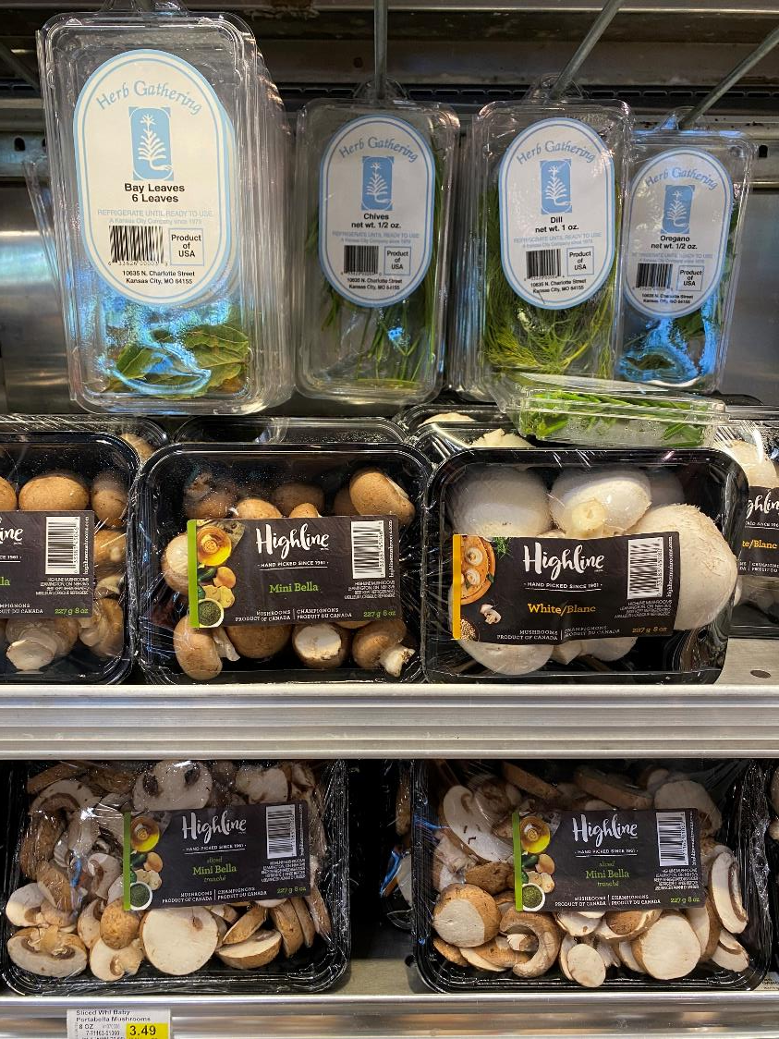
128
Fresh mushroom cross-purchase index with fresh herbs
The cross-purchase index shows what types of other items a mushroom household may be purchasing at a greater rate than the general population.
The analysis shows that fresh mushroom consumers love fresh herbs as well. While 35.8% of the total population bought fresh herbs in the past year, 45.7% of fresh mushroom consumers did, resulting in a 128 cross-purchase index. Co-merchandising, as done here by Price Chopper, may be a way to drive a bigger basket. The index is even higher for crimini mushrooms, at 143.
Source: IRI, Integrated Fresh, MULO, Cross-Purchase Index for the 52 w.e. 6-12-2022

Slide 41
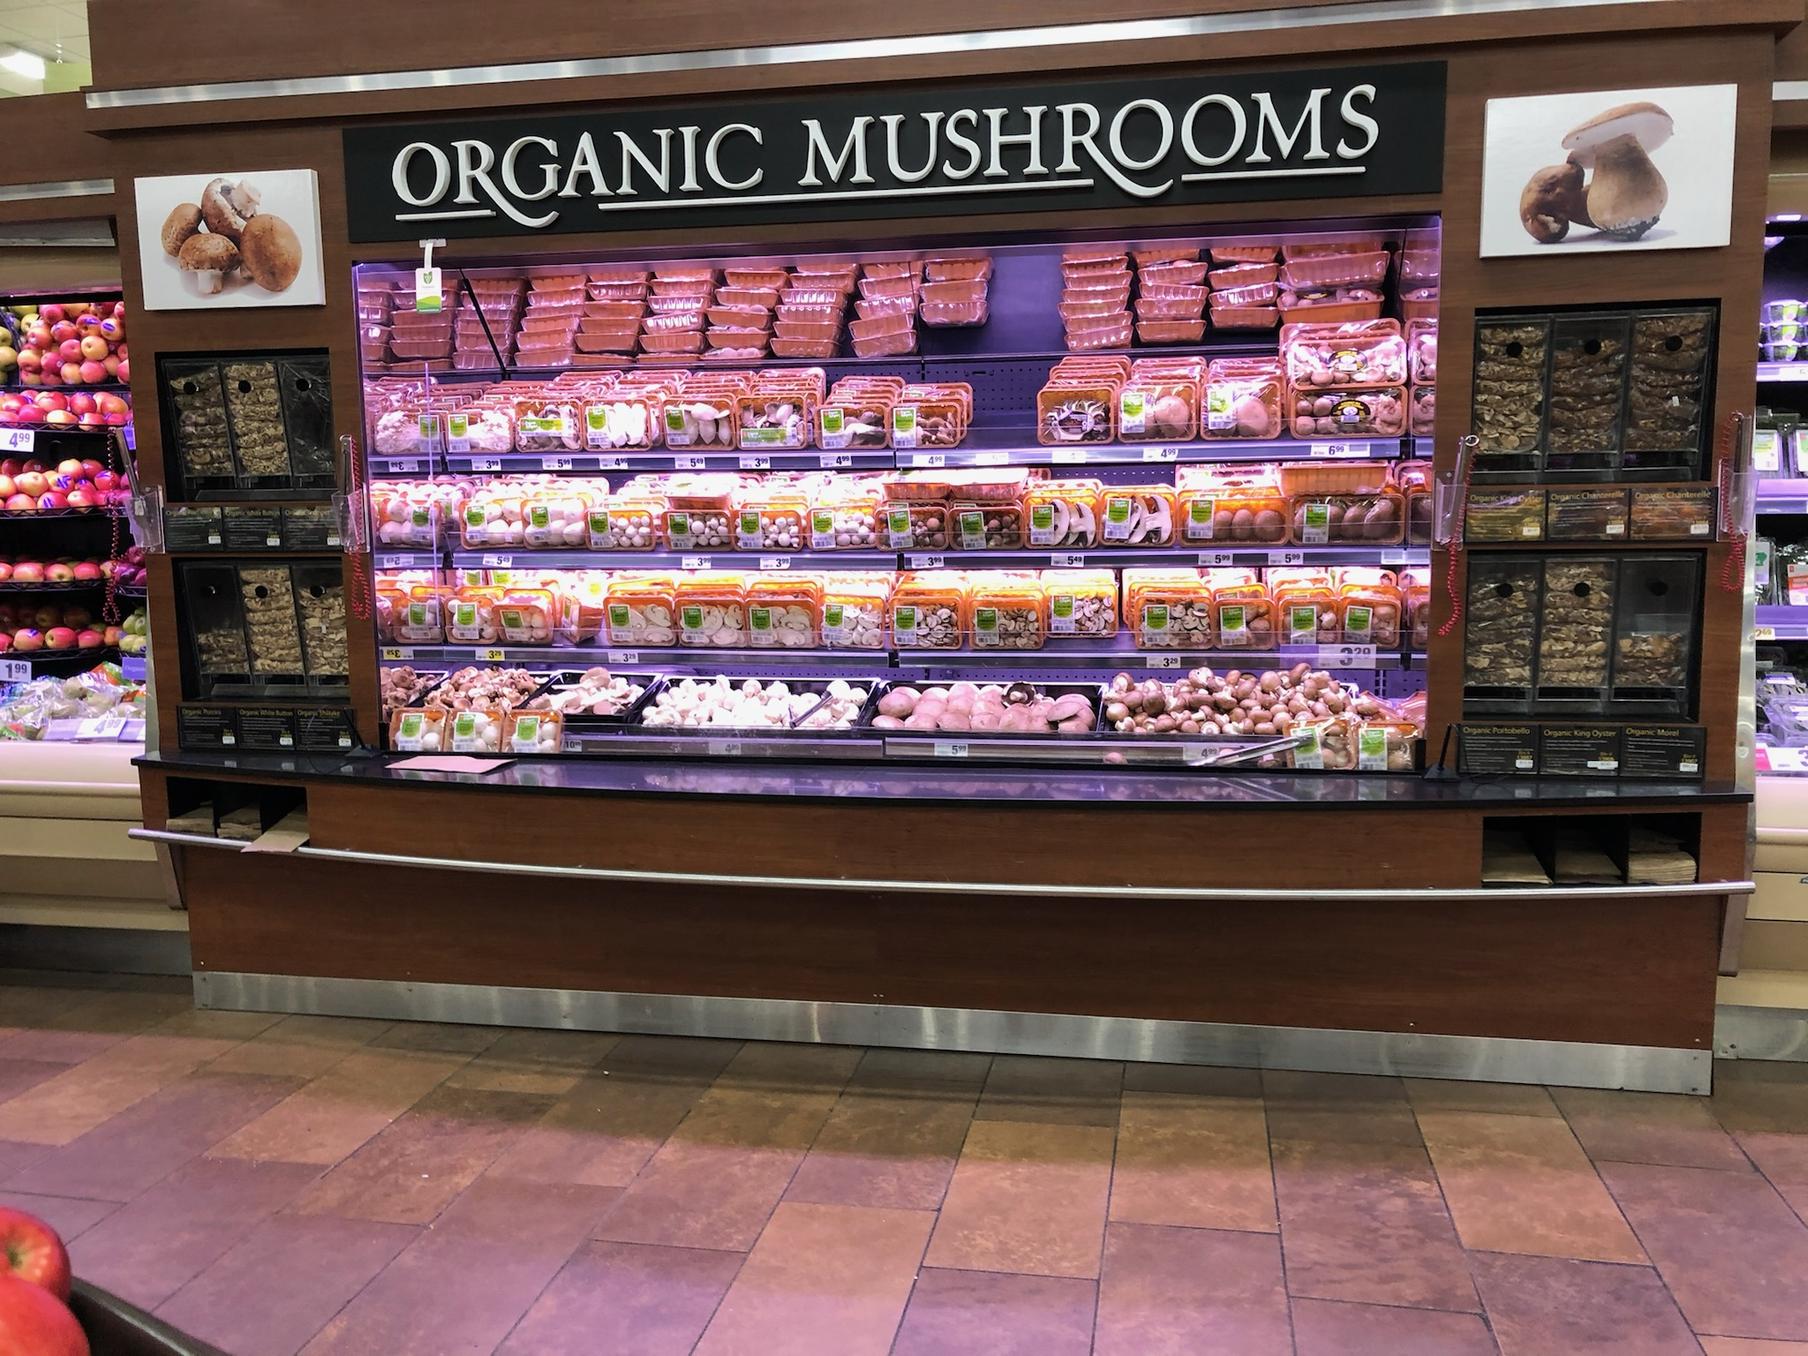
+1%
Organic mushroom sales YTD versus YA
While conventional mushrooms make up the bulk of sales, organic mushroom dollars sales are growing, especially in the specialty segment.
Organic specialty mushroom sales increased 33.7% YTD versus the same period year ago, driven by a strong performance in Shiitake.
Source: IRI, MULO, YTD through w.e. 8-7-2022

Slide 42
5%
Bulk mushroom’s share of total mushroom sales
With fewer retailers carrying bulk mushrooms, their share of dollars hovers around 5%. Retailers often leverage bulk to merchandise specialty mushrooms.
Bulk displays…
Can be of interest to drive trial as consumers can buy a limited amount to see if they are up for more
Can be useful for smaller households that may not need a full 8 or 16 ounces and want to prevent food waste
Source: IRI, Integrated Fresh, MULO, YTD weeks ending 8-7-2022

Slide 43
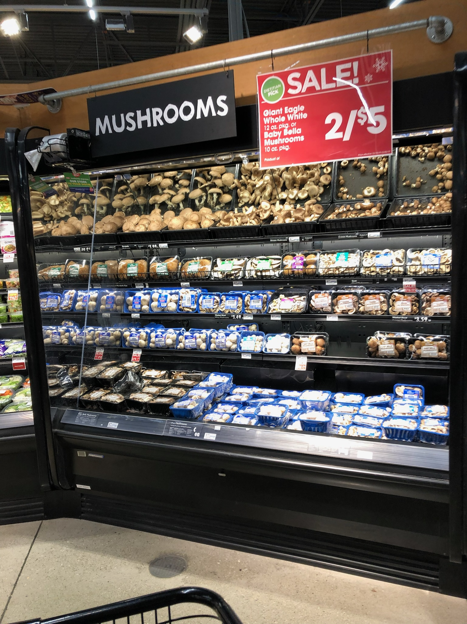
Dietitian pick
The COVID-19 pandemic drove many Americans to think more about their health — from general wellness to chronic disease management. Retail dietitians can be essential in helping Americans make healthier choices and ensuring focus is on evidence-based information that promotes health and prevents and manages chronic conditions in the long term.
At Giant Eagle, this 2 for $5 mushroom promotion deserved a “dietitian pick” label, recognizing mushrooms for their many nutritional benefits.
Source: Retail Dietitians Business Alliance (RDBA)

Slide 44
128
Fresh mushroom cross-purchase index with fresh herbs
The cross-purchase index shows what types of other items a mushroom household may be purchasing at a greater rate than the general population.
The analysis shows that fresh mushroom consumers love fresh herbs as well. While 35.8% of the total population bought fresh herbs in the past year, 45.7% of fresh mushroom consumers did, resulting in a 128 cross-purchase index. Co-merchandising, as done here by Price Chopper, may be a way to drive a bigger basket. The index is even higher for crimini mushrooms, at 143.
Source: IRI, Integrated Fresh, MULO, Cross-Purchase Index for the 52 w.e. 6-12-2022

