Slide 1
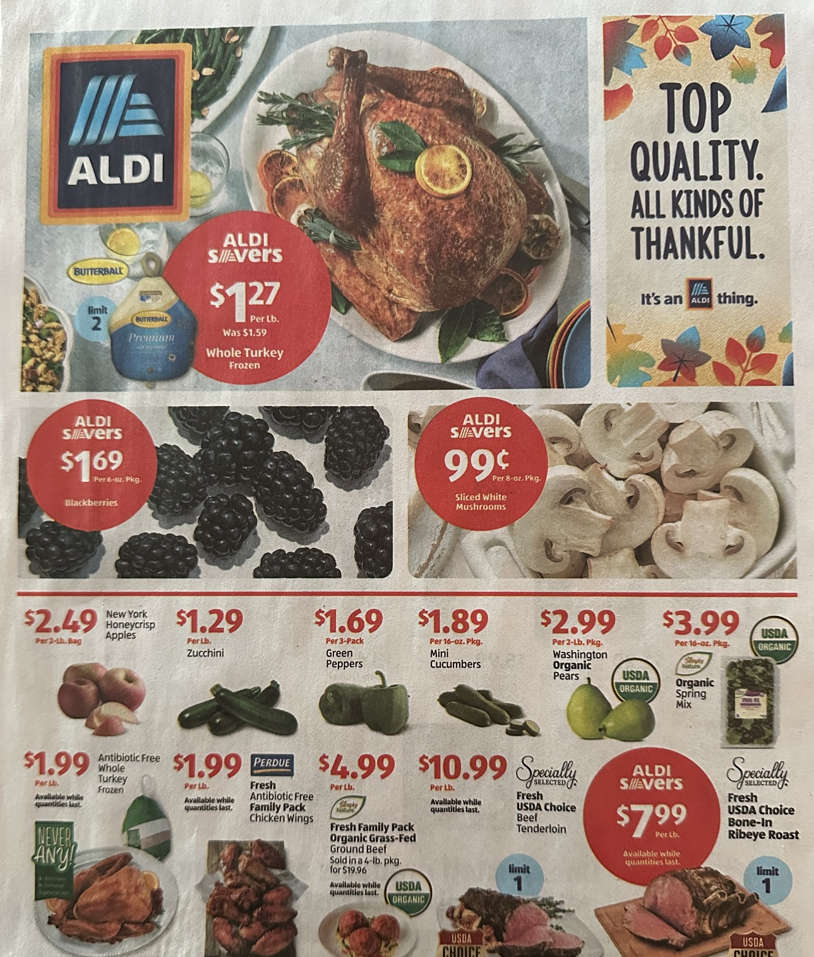
118
Dollar index for fresh mushroom sales during Thanksgiving week vs. the weekly average
Source: Circana, Integrated Fresh, MULO, 52 weeks ending 11/5/2023
Notes:
While mushrooms don’t have true seasons, like cherries, fresh mushroom sales do spike several times a year. The week of Thanksgiving and the week of Christmas drive the biggest spikes in fresh mushroom sales. Don’t miss out on these seasonal opportunities and lean in to existing patterns in purchasing and consumption to get that one extra purchase that makes or breaks the year. Better yet, understand the usage occasion and thus the ideal mushroom offering, whether sliced, stuffers or specialty mushrooms and support the occasion with prominent front-page placement in the ad — much like seen in the Aldi flyer for the week of Thanksgiving. For more insights and merchandising inspiration, visit www.mushroomcouncil.org!

Slide 2
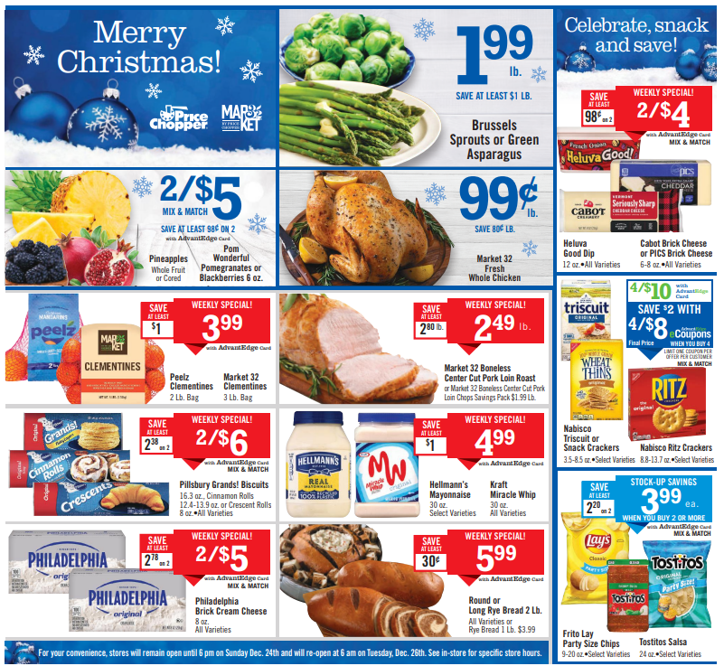
138
Dollar index for fresh mushroom sales during Christmas week vs. the weekly average
Source: Circana, Integrated Fresh, MULO, 52 weeks ending 11/5/2023
Notes:
While the two Thanksgiving weeks show impressive sales spikes for fresh mushrooms, the week of Christmas has, by far, the highest sales spike. The last week of the year indexes at 138, meaning sales are 38% higher than the average week in 2023. Don’t miss out on these seasonal opportunities and lean in to existing patterns in purchasing and consumption to get that one extra purchase that makes or breaks the year. Better yet, understand the usage occasion and thus the ideal mushroom offering, whether sliced, stuffers or specialty mushrooms and support the occasion with prominent front-page placement in the ad. For more insights and merchandising inspiration, visit www.mushroomcouncil.org!

Slide 3
43%
Of consumers say it’s important for restaurants to offer signature items that they can’t get elsewhere.
41% say it’s important to offer menu items with unique flavors. LTOs are a great way for retailers and operators to drive up demand and create buzz.
Source: Technomic 2020 future of FSR: Family Style and Casual Dining Consumer Trend Report
Notes:
Limited time offers (LTOs) are a powerful formula to boost engagement and sales for retail and foodservice alike. Consumers like an opportunity to be part of a unique dining experience and to shake things up from the routine same old dinner.
When time is limited and the offer is appealing, customers respond by driving up demand for an item, talking about it, and increasing its popularity. An LTOs success will depend on a number of factors, including how buzzworthy it is, how long it’s available, and its perceived value — to name a few. We might be a bit biased, but it sure seems this double mushroom Swiss LTO by @BurgerKing has all the right ingredients for a buzzworthy and sales boosting powerhouse.

Slide 4
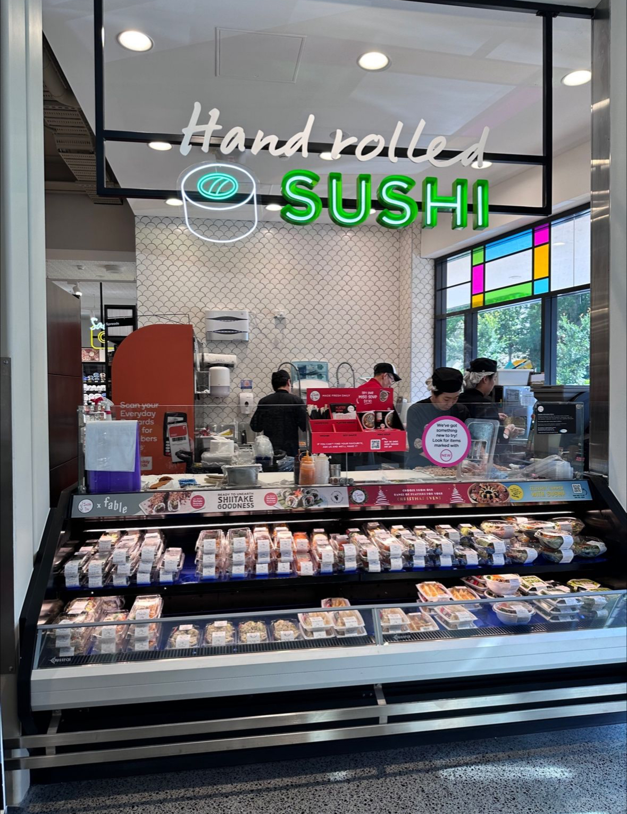
Shiitake sushi
$2.4 billion
Deli sushi sales have become a sales powerhouse. While tuna and salmon offerings dominate, some retailers are experimenting with plant-based sushi. In this case, a starring role for shiitake.
Source: Circana, Integrated Fresh, MULO, 52 weeks ending 11/5/2023
Notes:
Despite many years of growth, grocery stores continue to successfully build out their sushi programs with chef specials, sushi Wednesdays, different portion sizes and a host of interesting ingredients. This one caught our eye: shiitake mushrooms! A clever “ready to unearth shiitake goodness” alerts shoppers to existence of this unique sushi roll. Mushrooms versatility knows no bounds! For more insights and merchandising inspiration, visit www.mushroomcouncil.org!

Slide 5
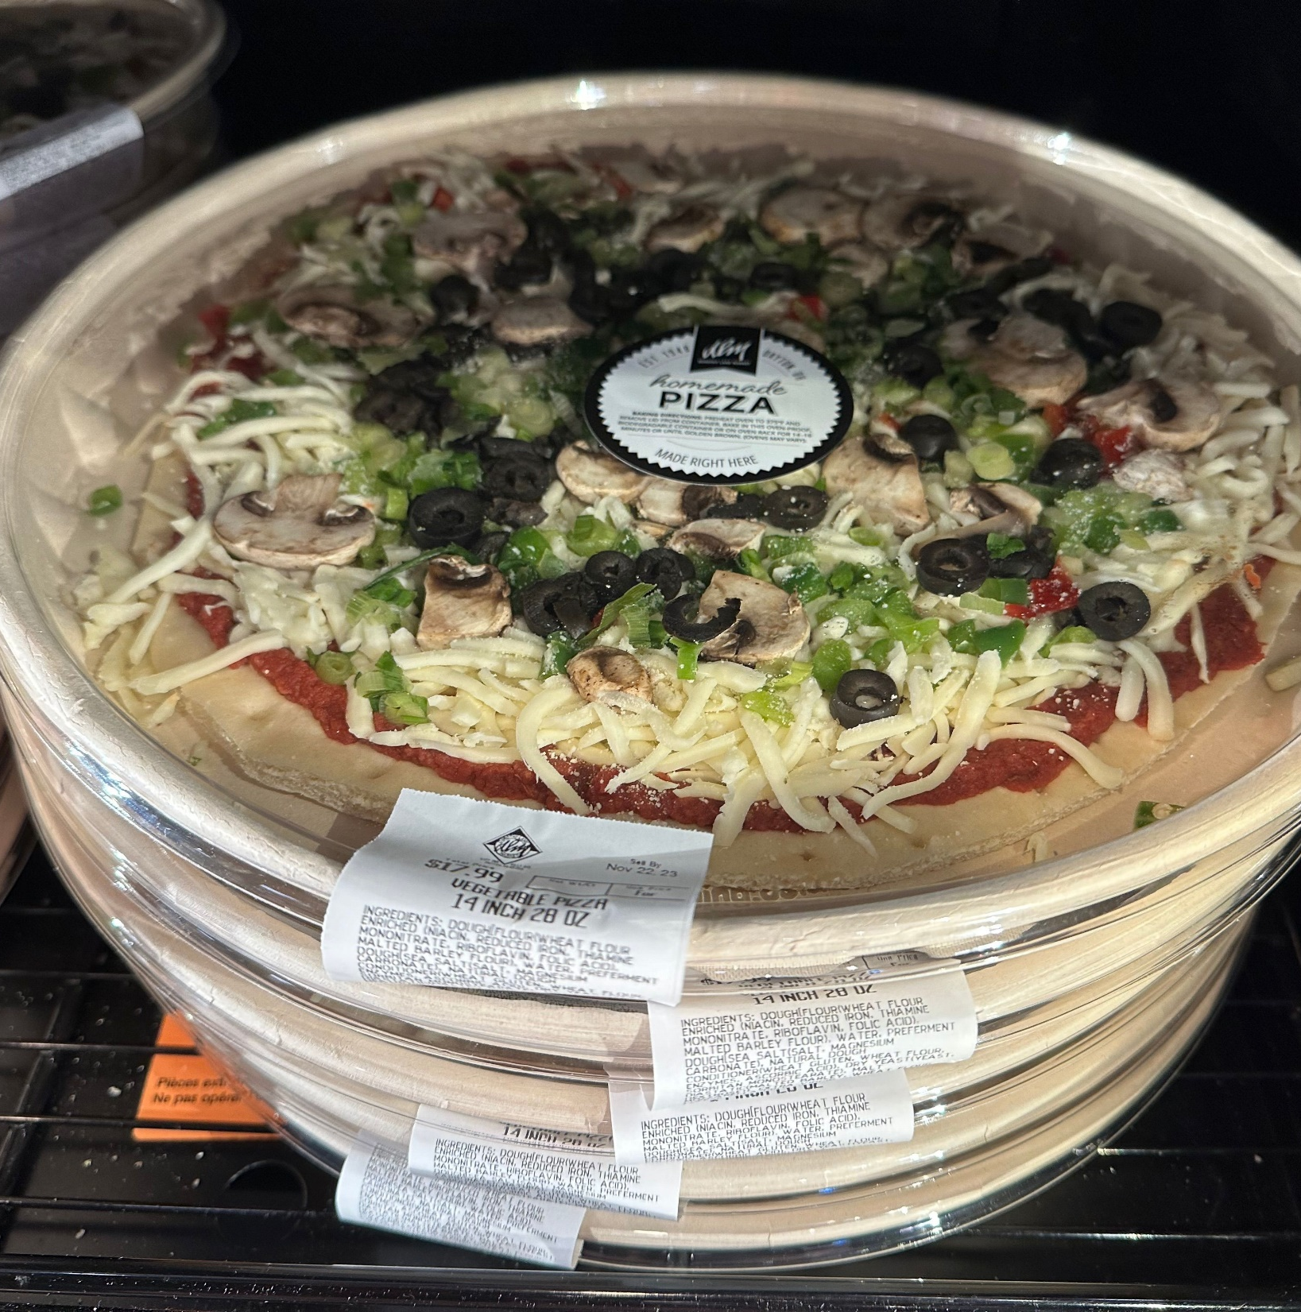
$886 million
Grocery deli-prepared pizza sales
Grocery stores are closing in on an important landmark: $1 billion in deli-prepared pizza sales.
Source: Circana, Integrated Fresh, MULO, 52 weeks ending 11/5/2023
Notes:
Three years ago, grocery deli pizza was a $654 million category. Fast-forward three years and it has risen to a $886 million powerhouse with offerings by the slice, a whole pizza, ready-to-bake, ready-to eat, make your own fresh ingredients and more. Mushrooms are a popular topping and can help premiumize the value of the pizza. For more insights and merchandising inspiration, visit www.mushroomcouncil.org!

Slide 6
122
Fresh mushroom cross-purchase index with Italian sausage
Stuffed mushrooms provide endless possibilities, from vegan and vegetarian options to this sausage pairing found at Kroger.
Fresh mushroom households purchase sausage at far greater rates than average — making this a very enticing offering for many.
Source: Circana, Integrated Fresh, MULO, Cross-Purchase Index for the 52 w.e. 6-12-2022
Notes:
Oven or air fryer-ready stuffed mushrooms are a fast-growing offering in the produce, deli and meat departments. Stuffed mushrooms are incredibly versatile and can be made into a center-of-plate protein alternative for vegans, vegetarians or those looking for some protein variety. But combined with ground meat or sausage, stuffed mushrooms can also combine the best of both worlds, such as seen here at Bel Air, a Raley’s banner, in the Sacramento, California area.
The cross-purchase index shows what types of other items a mushroom household may be purchasing at a greater rate than the general population. Fresh mushroom consumers are more likely to purchase ground sausage: while 13.3% of the total population bought random weight Italian sausage in the past year, 16.2% of fresh mushroom consumers did, resulting in a 122 cross-purchase index. For more insights and merchandising inspiration, visit www.mushroomcouncil.org!

Slide 7
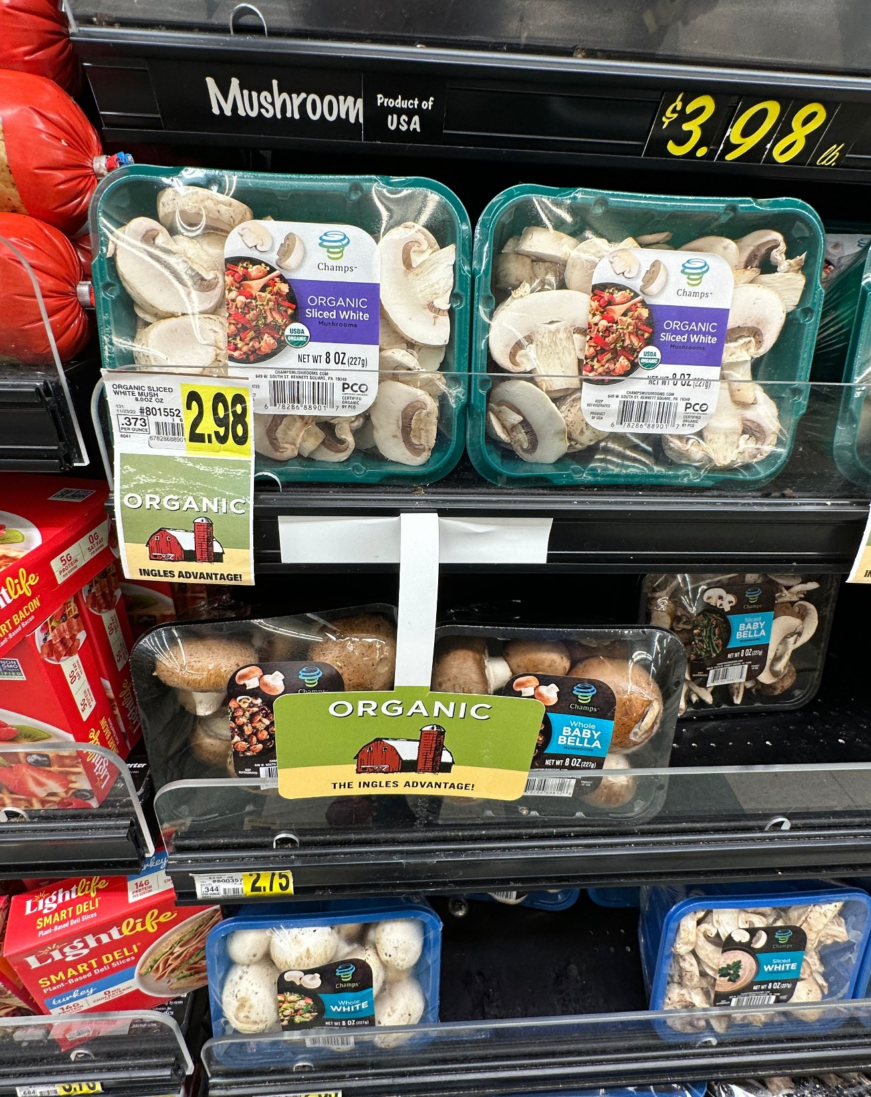
+1.2%
Increase of organic fresh mushroom pounds at retail
Organic sales are driving growth for fresh mushroom sales in the last quarter:
6.5 million pounds | +1.2% vs. year ago
Total vegetables 302 million pounds | -0.8%
Source: Circana, Integrated Fresh, Total US, MULO, 13 weeks ending 11/5/2023
Notes:
Organic mushrooms are making inroads with annual sales reaching $168 million, according to data insights firm Circana (formerly IRI). The performance for organic mushrooms is showing promise with strong third quarter 2023 sales growth in pounds. Organic mushrooms are outperforming the total organic vegetable category that experienced some pound pressure. For more insights and merchandising inspiration, visit www.mushroomcouncil.org!

