Slide 1
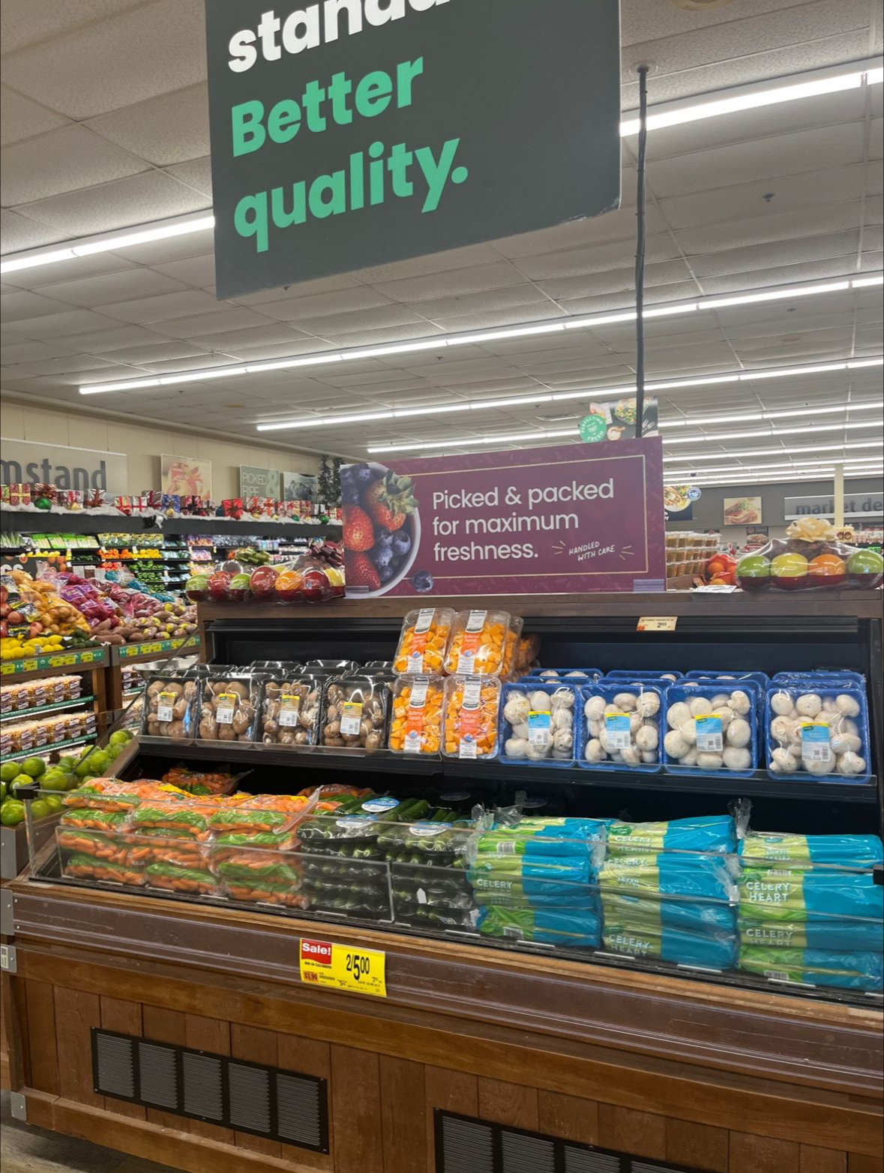
138
Dollar index for fresh mushroom sales during Christmas week vs. the weekly average
Source: Circana, Integrated Fresh, MULO, 52 weeks ending 11/5/2023
Notes:
The three biggest sales weeks of the year are surrounding the Thanksgiving and Christmas holidays. The last week of the year indexes at 138, meaning sales are 38% higher than the average week in 2023. Don’t miss out on these seasonal opportunities and lean in to existing patterns in purchasing and consumption to get that one extra purchase that can help bring home the win for the year. Integrate fresh mushrooms in the holiday produce set, right along with other seasonal classics such as celery, carrots, squash and cranberries. For more insights and merchandising inspiration, visit www.mushroomcouncil.org!

Slide 2
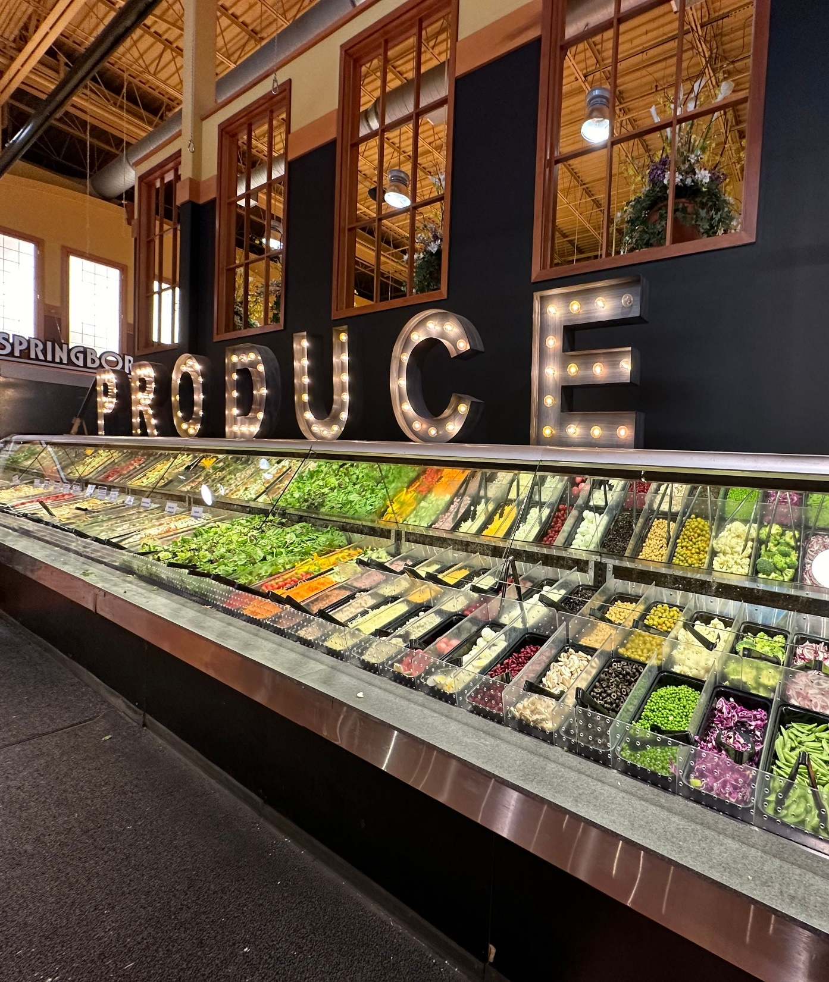
$4.3B
Deli salad sales at retail in 2023
Source: Circana, Integrated Fresh, Total US, MULO, 52 weeks ending 12/31/2023
Deli salads have grown to a $4.3 billion category over the past year, up 3.6% versus 2022. Whether the salad bar or pre-packaged salads, make sure to offer sliced mushrooms for that extra flavor and nutrition.
Source: Circana, Integrated Fresh, Total US, MULO, 52 weeks ending 12/31/2023
Notes:
Grocery deli prepared has emerged as one of the growth leaders in a difficult marketplace. Consumers recognize home-cooked meals are more cost effective than ordering from restaurants, but also value convenience and some time-saving solutions. Deli salad sales reached $4.3 billion in 2023 up from $3.1 billion in 2020, an increase of 37.1%. Units were flat in 2023, which is a far better accomplishments than most items around the store, and unit sales increased 12.1% compared to 2020. For more insights and merchandising inspiration, visit www.mushroomcouncil.org!

Slide 3
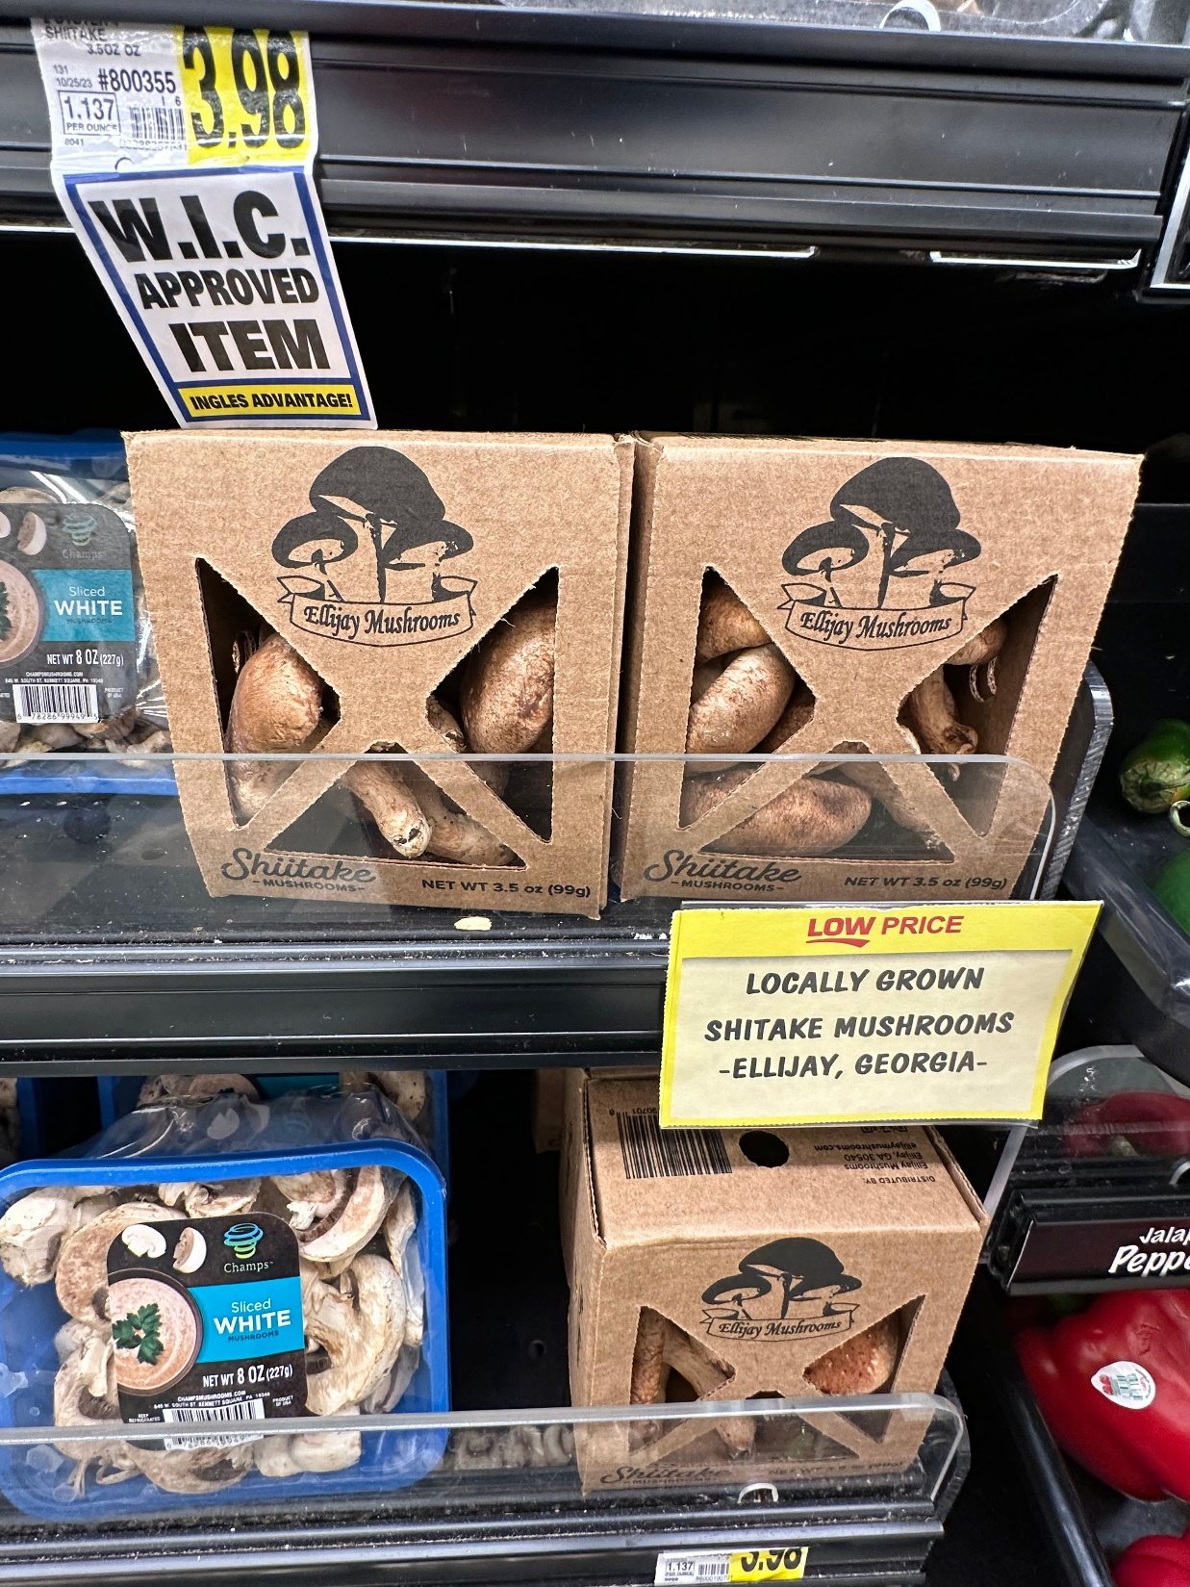
64%
Of produce shoppers want their produce department to carry more locally-grown items in their assortment
24%
of shoppers can be persuaded to make an impulse purchase when seeing a locally grown item
43%
Say a good variety of locally-grown items is a trait of a GREAT produce department
Source: FMI | The Power of Produce 2024
Notes:
Locally grown is a popular, cross-population growing attribute with staying power. Nearly two-thirds of shoppers would love to see more locally-sourced items. Locally-sourced has a different meaning for many retailers and consumers alike, ranging from country to city. Highlight grower partnerships for an extra reason to love mushrooms. For more insights and merchandising inspiration, visit www.mushroomcouncil.org!

Slide 4
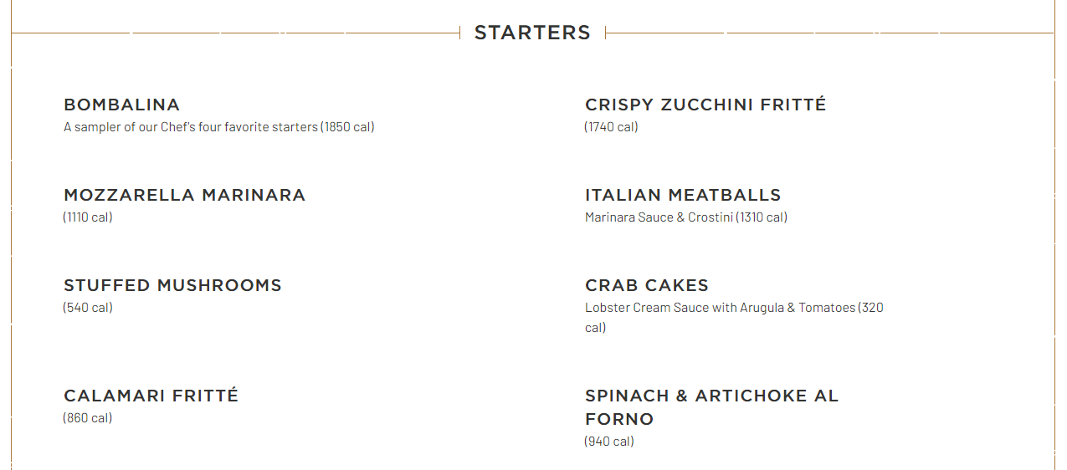
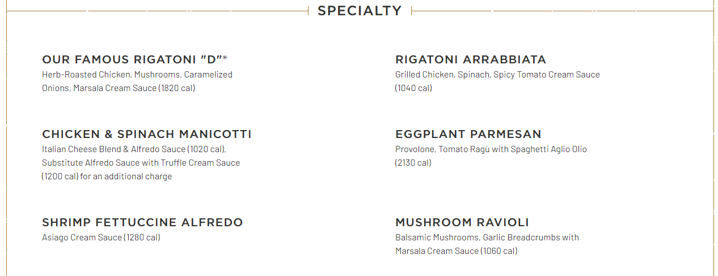
Mushroom menu introductions
Maggiano’s Little Italy
December 2023
New York Strip Contadina
A 16-ounce strip steak, Italian sausage links, roasted peppers and mushrooms
Notes:
Insights firm Datassential keeps an eye on exciting new menu introductions and flagged the December NY Strip Contadina on Maggiano’s LTO menu. Mushrooms are on the menu many times, including the stuffed mushroom appetizer that made the restaurant chain’s list of the most popular choices. This is right in line with the growing popularity of stuffed mushrooms at retail across the produce, meat and deli departments.

Slide 5
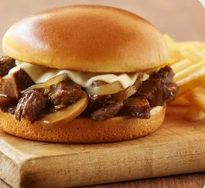
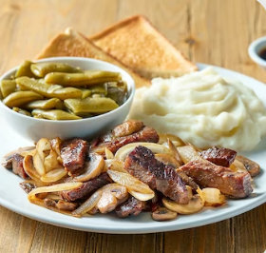
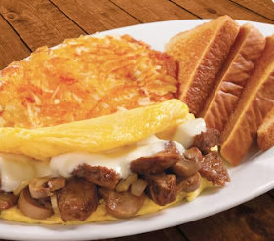
Mushroom menu introductions
Huddle House
November 2023
Roasted Prime Rib Tips Sandwich
Tender prime rib tips piled on a toasted brioche bun, topped with Swiss American cheese, sauteed mushrooms and caramelized onions, served with au jus.
Notes:
Insights firm Datassential keeps an eye on exciting new menu introductions and flagged three November 2023 LTOs on the Huddle House Menu. Guests could enjoy limited-time dishes with mushrooms for breakfast, lunch or dinner, with the choice of:
- The Roasted Prime Rib Tips Sandwich
- Prime Rib Tips Dinner
- Prime Rib Tips Omelet

Slide 6
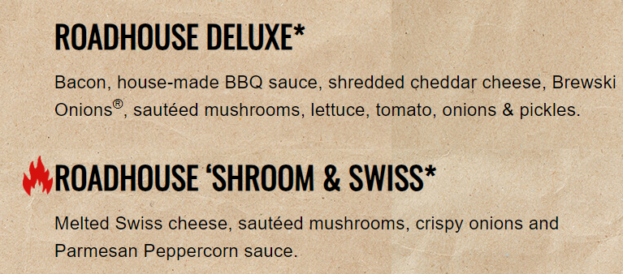
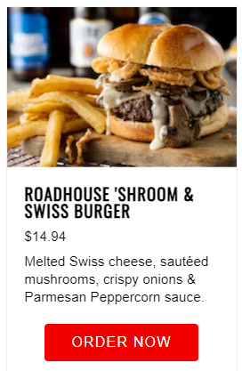
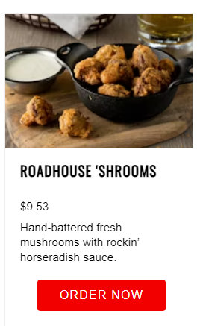
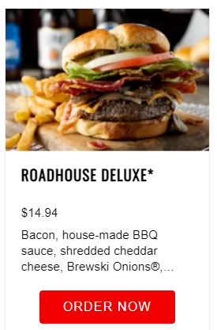
Mushroom menu introductions
Logan’s Roadhouse
November 2023
Roadhouse ‘Shroom & Swiss
Melted Swiss cheese, sautéed mushrooms, crispy onions and Parmesan Peppercorn sauce.
Notes:
Insights firm Datassential keeps an eye on exciting new menu introductions and flagged the new Roadhouse ‘Shroom & Swiss burger on the Logan Roadhouse menu. It is not the only burger featuring sauteed mushrooms. The Roadhouse Deluxe and the hand-battered fresh mushrooms with rockin’ horseradish sauce are other popular menu items.

Slide 7
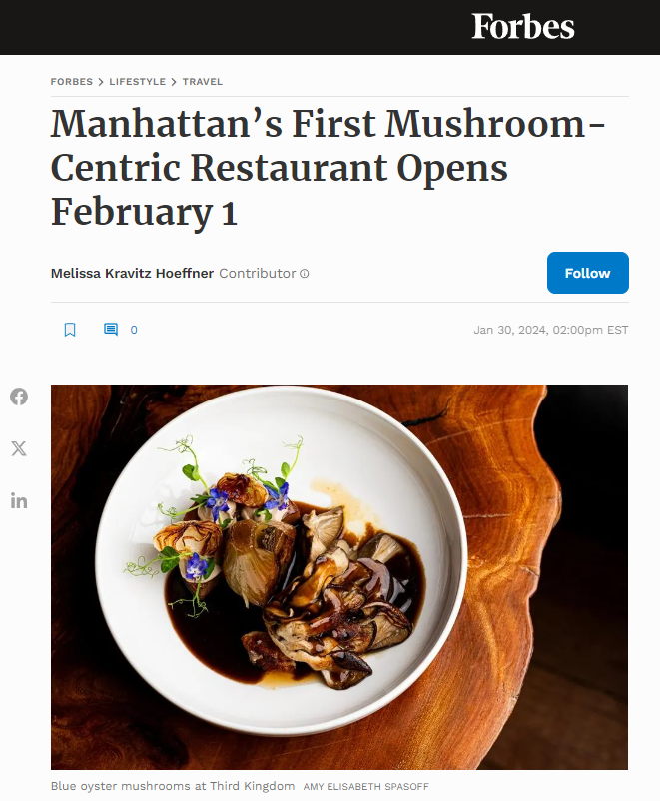
Mushroom menu introductions
Third Kingdom
New York, NY
Fungi are everywhere in 2024, and one restaurant is dedicating its entire menu to mycelium. Third Kingdom, New York’s first ever entirely mushroom-focused dining concept will open on Thursday, February 1 in the East Village.
Notes:
According to a January 30 article by Melissa Kravitz Hoeffner, New York will soon be able to enjoy not just a mushroom LTO or permanent menu feature, but an entire mushroom-based restaurant. A direct quote from the article:
“It’s no secret that mushrooms have skyrocketed in popularity over the past decade, and the incredible response to &Beer encouraged us to take mushroom-centric dining to the next level,” DeRossi, who was recently nominated for a 2024 James Beard Award for Outstanding Restaurateur.

Slide 8
Product | Dollars | $ vs. YA | $ vs. 2YA | $ vs. 3YA | Units | Units vs. YA | Unit Sales Change vs 3 YA | Unit Sales % Change vs 3 YA
DELI SALADS | $4,295,701,083 | 3.6% | 15.4% | 37.1% | 832,717,144 | -0.1% | 89,582,321 | 12.1%

