Slide 1
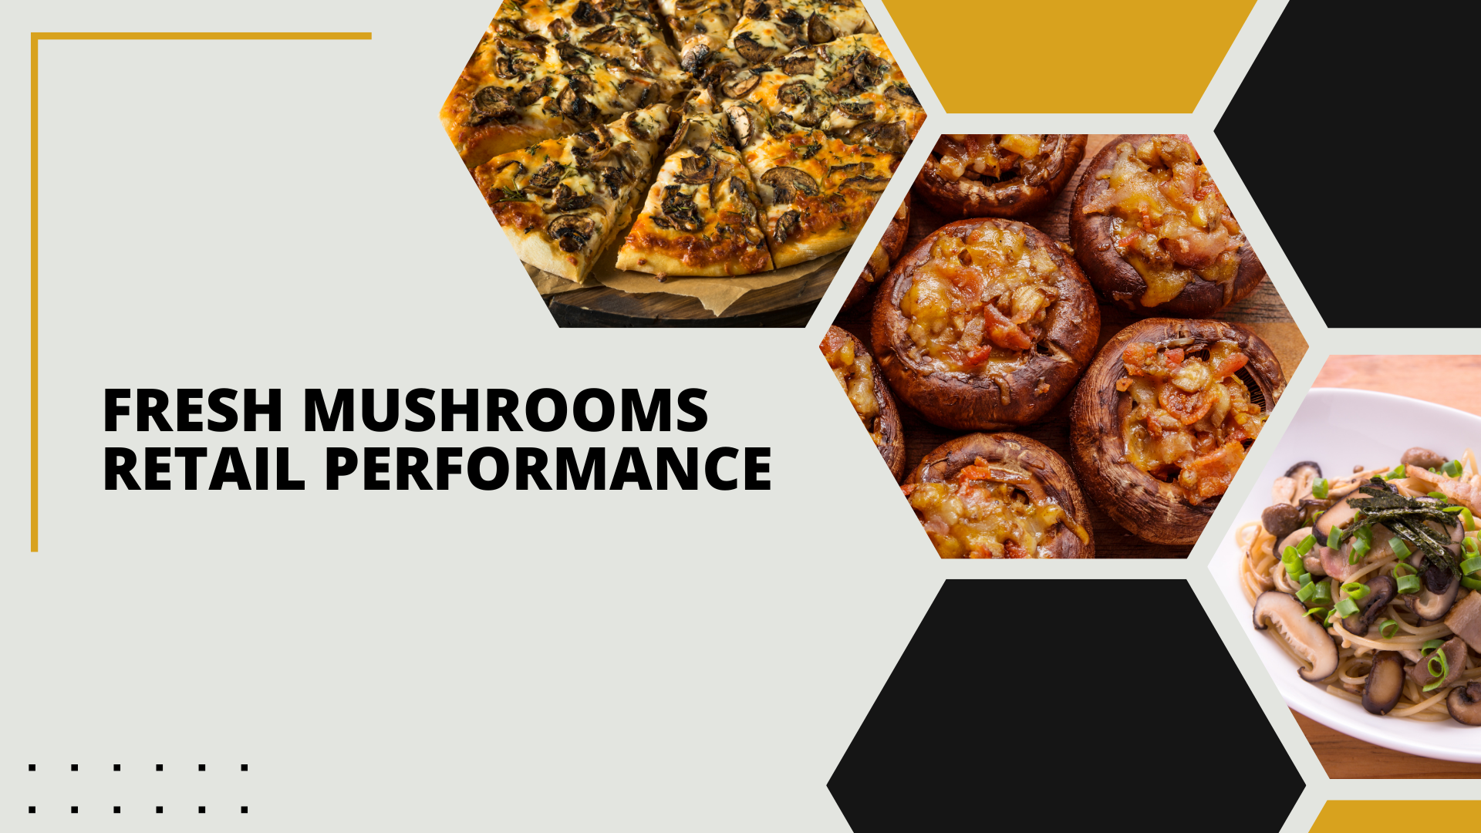

Period ending
December 1, 2024

Slide 2
Methodology
The report covers the four weeks ending December 1, 2024 with week endings:
  November 10, 2024
  November 17, 2024
  November 24, 2024
  December 1, 2024
Dollar references are the retail value, volume is reflected in pounds and units (packages)
Package size, organic, fixed/random weight and value-added now all reflect the MULO+ expanded marketplace
For questions, contact Anne-Marie Roerink, at aroerink@210analytics.com
Source: Circana, Integrated Fresh, MULO+, 4 weeks ending 12/1/2024

Slide 3
Four-year dollar sales trend
Dollar sales are down about $2 million from last year in the four-week view
Source: Circana, Integrated Fresh, MULO+, 4 weeks and 52 w.e. 12/1/2024 versus same periods the past four years

Slide 4
Four-year unit sales trend
Unit sales declined more than volume, given the strength in 24-ounce packages
Source: Circana, Integrated Fresh, MULO+, 4 weeks and 52 w.e. ending 12/1/2024 versus same periods the past four years

Slide 5
Four-year volume (pound) sales trend
In the quad-week period, pound sales trended very closely to last year
Source: Circana, Integrated Fresh, MULO+, 4 weeks and 52 w.e. ending 12/1/2024 versus same periods the past four years

Slide 6
Mushroom contribution to the department and category
This quad-week period has an above-average share of dollars compared to the rest of the week
4 weeks Mushroom $ share | Share of total produce | Share of total vegetables
3YA | 2.2% | 4.1%
2YA | 2.1% | 4.1%
YA | 2.0% | 3.7%
4 w.e. 12/1/2024 | 1.9% | 3.7%
52 weeks Mushroom $ share | Share of total produce | Share of total vegetables
3YA | 2.0% | 4.0%
2YA | 1.9% | 3.9%
YA | 1.8% | 3.7%
52 w.e. 12/1/2024 | 1.7% | 3.5%
Source: Circana, Integrated Fresh, MULO+, 4 weeks and 52 w.e. ending 12/1/2024

Slide 7
Mushrooms price per unit
On a per unit basis, vegetable prices increased a little over 1%, while mushroom prices were mostly flat
4 weeks Average price/unit | Total produce | Total vegetables | Mushrooms
3YA | $2.50 | $2.24 | $2.91
2YA | $2.64 | $2.44 | $3.11
YA | $2.71 | $2.39 | $3.08
4 w.e. 12/1/2024 | $2.71 | +0.2% | $2.42 | +1.1% | $3.09 | +0.5%
Source: Circana, Integrated Fresh, MULO+, YTD weeks ending 12/1/2024

Slide 8
Mushroom price per volume (pound)
On a per pound basis, mushroom prices decreased a little in the quad week
4 weeks Average price/pound | Total produce | Total vegetables | Mushrooms
3YA | $1.73 | $1.73 | $4.30
2YA | $1.83 | $1.86 | $4.58
YA | $1.86 | $1.83 | $4.55
4 w.e. 12/1/2024 | $1.86 | -0.2% | $1.82 | -0.4% | $4.53 | -0.5%
Source: Circana, Integrated Fresh, MULO+, YTD weeks ending 12/1/2024

Slide 9
Price per volume by quarter/month
Prices were similar to those seen in the second quarter of the year
Source: Circana, Integrated Fresh, MULO+, 2019-w.e. 12/1/2024

Slide 10
Price by type
4 w.e.12/1/2024 | Price per unit | % change vs. YA
Total mushrooms | $3.09 | +0.5%
White mushrooms | $2.72 | -0.1%
Crimini mushrooms | $3.48 | -0.7%
Portabella mushrooms | $2.68 | +9.8%
Specialty mushrooms | $5.86 | -2.7%
4 w.e. 12/1/2024 | Price per volume | % change vs. YA
Total mushrooms | $4.53 | -0.5%
White mushrooms | $3.98 | -1.3%
Crimini mushrooms | $4.60 | -0.4%
Portabella mushrooms | $5.34 | +10.3%
Specialty mushrooms | $13.95 | +0.0%
Specialty mushrooms include shiitake, oyster, enoki, chanterelle, morel, wood ear, porcini, black forest, lion’s mane and other
Source: Circana, Integrated Fresh, MULO+, 4 w.e. 12/1/2024

Slide 11

Mushroom dollar, unit, volume sales
Dollar and volume sales are starting to level off, driven by 24-ounce packages
4 w.e. 12/1/2024 dollars
$123.7M
volume (lbs)
25.3M
-1.8%
-2.2%
-1.3%
Dollar
growth vs. YA
Unit
growth vs. YA
Volume
growth vs. YA
-3.8% vs. 2YA
-1.2% vs. 3YA
-3.2% vs. 2YA
-7.0% vs. 3YA
-2.8% vs. 2YA
-6.3% vs. 3YA
Source: Circana, Integrated Fresh, MULO+, 4 weeks ending 12/1/2024

Slide 12
Vegetables and mushroom pound sales vs. YA
Vegetables continue to have a strong 2024 with accelerating growth
Source: Circana, Integrated Fresh, MULO+, 2020 -w.e. 12/1/2024

Slide 13
Share of dollars sold on merchandising
Promotional levels increased during the past four weeks, likely due to the Thanksgiving promotions
Fresh mushrooms | 4 w.e. 12/1/2024 | Vs. YA | Latest 52 w.e. 12/1/2024 | Vs. YA
Share of dollars sold on promotion | 19.2% | +4.1% | 17.8% | +3.8%
* Any merchandising, including feature, display, feature & display and temporary price reductions
Source: Circana, Integrated Fresh, MULO+, latest 4 w.e. 12/1/2024

Slide 14
Over indexing versus under indexing regions
In dollars, the performances in the Midsouth, Northeast, Southeast and West were better than average
Use as comparison to understand importance/size of mushrooms
L-52 w.e. 12/1/2024 | Share of veg. $ | Share of mushrooms $ | $ sales growth vs. YA
Total US | 100.0% | 100.0% | -1.8%
California | 12.1% | 14.1% | -2.1%
Great Lakes | 13.3% | 14.9% | -2.2%
Mid-South | 13.0% | 11.4% | -1.2%
Northeast | 17.5% | 17.5% | -1.2%
Plains | 6.6% | 6.4% | -2.6%
South Central | 8.9% | 6.8% | -3.7%
Southeast | 15.5% | 13.4% | -1.2%
West | 13.1% | 15.4% | -1.5%
WEST
PLAINS
GREAT LAKES
NORTHEAST
MID SOUTH
CALIFORNIA
SOUTHEAST
SOUTH CENTRAL
= Above-average share vs. veg
= Above-average
performance vs. total US
Source: Circana, Integrated Fresh, MULO+, L52 w.e. 12/1/2024 | Total fresh vegetables and total fresh mushrooms

Slide 15
Performance summary whites, browns and specialty
Crimini mushrooms had the strongest dollar and volume performance; the share of white is elevated compared to a non-holiday quad week
4 weeks ending 12/1/2024 | Dollars | Dollar share | $ sales vs. YA | $ sales vs. 2YA | Volume (lbs) | Lbs share | Lbs vs. YA | Lbs vs. 2YA
Total fresh mushrooms | $123.7M | 100.0% | -1.8% | -3.8% | 27.3M | 100.0% | -1.3% | -2.8%
White mushrooms | $61.2M | 49.5% | -1.6% | -5.4% | 15.4M | 56.4% | -0.3% | -5.2%
Crimini mushrooms | $44.3M | 35.8% | -0.6% | -1.8% | 9.6M | 35.3% | -0.2% | +0.6%
Portabella mushrooms | $8.4M | 6.8% | -5.9% | -6.2% | 1.6M | 5.8% | -14.7% | +0.3%
Specialty mushrooms | $8.4M | 6.9% | -4.8% | -0.5% | 0.6M | 2.2% | -4.8% | -0.7%
Source: Circana, Integrated Fresh, MULO+, 4 weeks ending 12/1/2024

Slide 16

Other insights
Packaged (fixed weight) versus random weight
Package-size analysis
Organic versus conventional
Value-added versus whole/uncut

Slide 17
Package size analysis
8-ounce packs drove the bulk of sales but 24-ounce packages have overtaken 16-ounce packages with growth in dollars, units and volume
Package size (per UPC) 52 weeks | Dollars | $ vs. YA | Units | % vs. YA | Volume | lbs vs. YA
8 OZ | $734.4M | -1.8% | 312.6M | -2.2% | 156.3M | -2.2%
16 OZ | $236.6M | -5.1% | 58.4M | -7.9% | 58.4M | -7.9%
24 OZ | $243.8M | +1.9% | 47.7M | +2.4% | 71.6M | +2.4%
Source: Circana, Integrated Fresh, MULO+, 52 weeks ending 12/1/2024

Slide 18
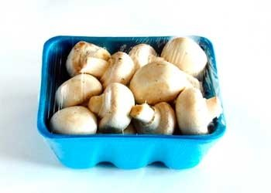
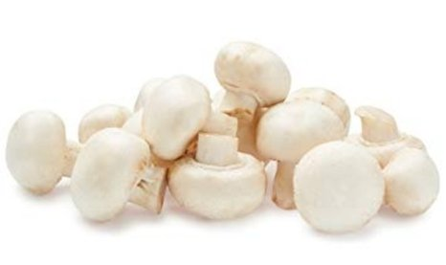
Packaged (fixed weight) versus random weight
Fixed-weight dollar sales outperformed random weight
52 w.e. 12/1/2024 | Share of total mushroom sales and sales growth %
 | Fixed weight | Random weight
Dollar growth | -1.7% | -5.0%
Share of mushroom $ sales | 96.6% | 3.4%
Volume growth | -2.5% | -3.4%
Share of mushroom lbs sales | 97.0% | 3.0%
Source: Circana, Integrated Fresh, MULO+, 4 weeks ending 12/1/2024

Slide 19
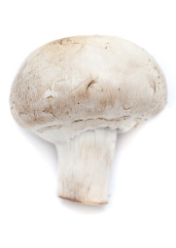
Organic versus conventional mushrooms sales
Organic mushrooms increased volume sales with a shift to larger pack sizes
52 w.e. 12/1/2024 | Share of total mushroom sales and sales growth %
Market
size
$1.2B
$ growth
-3.2%
Unit growth
-3.4%
Volume
growth
-4.3%
Conventional
Market size
$338M
$ growth
+3.6%
Unit growth
+1.3%
Volume
growth
+5.1%
Organic
Source: Circana, Integrated Fresh, MULO+, 4 weeks ending 12/1/2024 compared with year ago

Slide 20
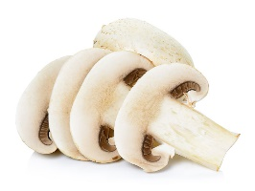
Cut/prepared versus whole mushrooms
Whole and sliced had a very similar performance
52 w.e. 12/1/2024 | Share of total mushroom sales and sales growth %
Market
size
$892M
$ growth
-0.9%
Unit growth
-1.6%
Volume
growth
-1.6%
Whole
Market size
$632M
$ growth
-3.0%
Unit growth
-4.2%
Volume
growth
-4.2%
Value-added
Source: Circana, Integrated Fresh, MULO+, 4 weeks ending 12/1/2024 compared with year ago

