Slide 1
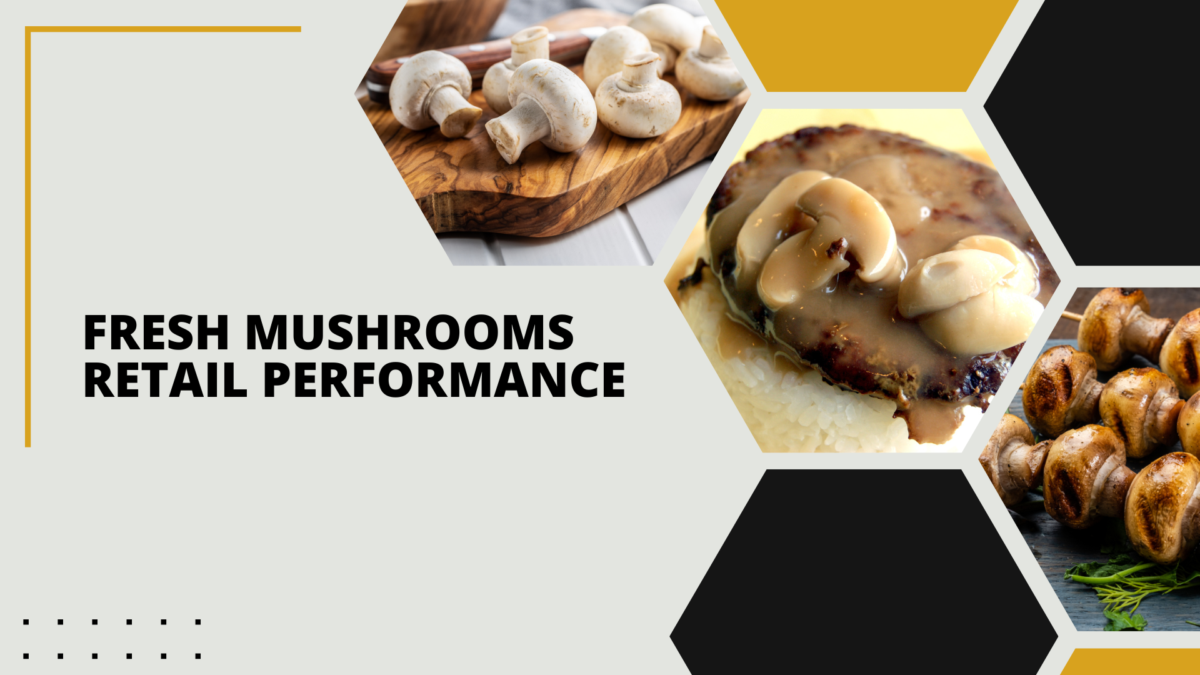

Period ending
December 29, 2024

Slide 2
Methodology
The report covers the four weeks ending December 29, 2024 with week endings:
  December 8, 2024
  December 15, 2024
  December 22, 2024
  December 29, 2024
Please note, during this quad-week, the year-over-year performance is affected by the date cut-off (which is always on a Sunday). In 2023, the corresponding quad-week ended on 12/31 versus 12/29 this year. That means much of the New Year’s food dollar was captured in quad week 13 in 2023, but will move, in part, into quad week 1 of 2025 due to the Wednesday timing of the holiday.
Dollar references are the retail value, volume is reflected in pounds and units (packages)
Package size, organic, fixed/random weight and value-added now all reflect the MULO+ expanded marketplace
For questions, contact Anne-Marie Roerink, at aroerink@210analytics.com
Source: Circana, Integrated Fresh, MULO+, 4 weeks ending 12/29/2024

Slide 3
Four-year dollar sales trend
While this quad-week does show a decreasing five-year trend line, the year-over-year drop was accentuated by the cut-off date
Source: Circana, Integrated Fresh, MULO+, 4 weeks and 52 w.e. 12/29/2024 versus same periods the past four years

Slide 4
Four-year unit sales trend
Unit sales have declined by more than 100 million packages in comparison to four years ago, however, larger pack sizes (16 and 24 ounce) make up some of the difference
Source: Circana, Integrated Fresh, MULO+, 4 weeks and 52 w.e. ending 12/29/2024 versus same periods the past four years

Slide 5
Four-year volume (pound) sales trend
While typically a strong quad-week for fresh mushrooms, pound sales fell slightly below 27 million pounds this year
Source: Circana, Integrated Fresh, MULO+, 4 weeks and 52 w.e. ending 12/29/2024 versus same periods the past four years

Slide 6
Mushroom contribution to the department and category
This quad-week period has an above-average share of dollars compared to the rest of the week
4 weeks Mushroom $ share | Share of total produce | Share of total vegetables
3YA | 2.2% | 4.1%
2YA | 2.1% | 4.1%
YA | 2.0% | 3.7%
4 w.e. 12/29/2024 | 1.9% | 3.7%
52 weeks Mushroom $ share | Share of total produce | Share of total vegetables
3YA | 2.0% | 4.0%
2YA | 1.9% | 3.9%
YA | 1.8% | 3.7%
52 w.e. 12/29/2024 | 1.7% | 3.5%
Source: Circana, Integrated Fresh, MULO+, 4 weeks and 52 w.e. ending 12/29/2024

Slide 7
Mushrooms price per unit
On a per unit basis, total produce experienced a bit of inflation this quad week, driven by vegetables. In contrast, mushroom prices decreased
4 weeks Average price/unit | Total produce | Total vegetables | Mushrooms
3YA | $2.57 | $2.28 | $2.93
2YA | $2.71 | $2.48 | $3.15
YA | $2.75 | $2.43 | $3.13
4 w.e. 12/29/2024 | $2.77 | +0.7% | $2.46 | +1.2% | $3.08 | -1.6%
Source: Circana, Integrated Fresh, MULO+, YTD weeks ending 12/29/2024

Slide 8
Mushroom price per volume (pound)
On a per pound basis, mushrooms were also the exception with a 1.3% year-over-year increase during the quad-week, versus increases for vegetables and total produce
4 weeks Average price/pound | Total produce | Total vegetables | Mushrooms
3YA | $1.81 | $1.83 | $4.33
2YA | $1.91 | $1.97 | $4.60
YA | $1.92 | $1.92 | $4.56
4 w.e. 12/29/2024 | $1.95 | +1.3% | $1.96 | +1.8% | $4.50 | -1.3%
Source: Circana, Integrated Fresh, MULO+, YTD weeks ending 12/29/2024

Slide 9
Price per volume by quarter/month
Q4 prices were the lowest of the year, albeit a mere few cents per pound
Source: Circana, Integrated Fresh, MULO+, 2019-w.e. 12/29/2024

Slide 10
Price by type
4 w.e.12/29/2024 | Price per unit | % change vs. YA
Total mushrooms | $3.08 | -1.6%
White mushrooms | $2.73 | -1.3%
Crimini mushrooms | $3.47 | -1.6%
Portabella mushrooms | $2.55 | -5.5%
Specialty mushrooms | $5.78 | +1.8%
4 w.e. 12/29/2024 | Price per volume | % change vs. YA
Total mushrooms | $4.50 | -1.3%
White mushrooms | $3.98 | -1.6%
Crimini mushrooms | $4.56 | -0.9%
Portabella mushrooms | $5.10 | -4.8%
Specialty mushrooms | $13.74 | -0.2%
Specialty mushrooms include shiitake, oyster, enoki, chanterelle, morel, wood ear, porcini, black forest, lion’s mane and other
Source: Circana, Integrated Fresh, MULO+, 4 w.e. 12/29/2024

Slide 11

Mushroom dollar, unit, volume sales
The quad-week was impacted by the date cut-off and showed larger declines than we have seen in recent months
4 w.e. 12/29/2024 dollars
$121.0M
volume (lbs)
26.9M
-4.8%
-3.3%
-3.6%
Dollar
growth vs. YA
Unit
growth vs. YA
Volume
growth vs. YA
-6.5% vs. 3YA
-7.0% vs. 3YA
-10.0% vs. 3YA
Source: Circana, Integrated Fresh, MULO+, 4 weeks ending 12/29/2024

Slide 12
Vegetables and mushroom pound sales vs. YA
Vegetables had an off quad-week as well. Gains had been trending around 2% year-on-year, but dropped to +0.5% for quad-week 13.
Source: Circana, Integrated Fresh, MULO+, 2020 -w.e. 12/29/2024

Slide 13
Share of dollars sold on merchandising
Promotional levels increased during the past four weeks, likely due to the Thanksgiving promotions
Fresh mushrooms | 4 w.e. 12/29/2024 | Vs. YA | Latest 52 w.e. 12/29/2024 | Vs. YA
Share of dollars sold on promotion | 18.0% | +15.6% | 18.0% | +3.8%
* Any merchandising, including feature, display, feature & display and temporary price reductions
Source: Circana, Integrated Fresh, MULO+, latest 4 w.e. 12/29/2024

Slide 14
Over indexing versus under indexing regions
Two regions substantially pulled down volume sales during this quad week, being the Northeast and the Southeast. Pound sales in the Great Lakes were mostly flat
Use as comparison to understand importance/size of mushrooms
L-4 w.e. 12/29/2024 | Share of veg. lbs | Share of mushroom lbs | lbs sales growth vs. YA
Total US | 100.0% | 100.0% | -3.6%
California | 10.8% | 12.7% | -2.3%
Great Lakes | 14.4% | 14.8% | -0.4%
Mid-South | 13.4% | 11.5% | -3.0%
Northeast | 15.8% | 19.0% | -5.9%
Plains | 7.0% | 6.5% | -1.1%
South Central | 10.6% | 7.0% | -2.6%
Southeast | 15.2% | 14.4% | -8.2%
West | 12.8% | 14.2% | -1.8%
WEST
PLAINS
GREAT LAKES
NORTHEAST
MID SOUTH
CALIFORNIA
SOUTHEAST
SOUTH CENTRAL
= Above-average share vs. veg
= Above-average
performance vs. total US
Source: Circana, Integrated Fresh, MULO+, L52 w.e. 12/29/2024 | Total fresh vegetables and total fresh mushrooms

Slide 15
Performance summary whites, browns and specialty
Where crimini mushrooms have had the better performance, whites did better this quad week, due to light mushroom users coming into the category for the holidays.
4 weeks ending 12/29/2024 | Dollars | Dollar share | $ sales vs. YA | $ sales vs. 2YA | Volume (lbs) | Lbs share | Lbs vs. YA | Lbs vs. 2YA
Total fresh mushrooms | $121.0M | 100.0% | -4.8% | -6.5% | 26.9M | 100.0% | -3.6% | -10.0%
White mushrooms | $59.9M | 49.5% | -5.0% | -10.5% | 15.1M | 56.1% | -3.5% | -13.6%
Crimini mushrooms | $43.2M | 35.7% | -5.6% | +1.1% | 9.5M | 35.3% | -4.8% | -2.4%
Portabella mushrooms | $8.5M | 7.0% | -1.9% | -26.9% | 1.7M | 6.2% | +3.1% | -21.5%
Specialty mushrooms | $8.0M | 6.7% | -1.0% | +18.2% | 0.6M | 2.2% | -0.9% | +16.6%
Source: Circana, Integrated Fresh, MULO+, 4 weeks ending 12/29/2024

Slide 16

Other insights
Packaged (fixed weight) versus random weight
Package-size analysis
Organic versus conventional
Value-added versus whole/uncut

Slide 17
Package size analysis
8-ounce packs drove the bulk of sales but 24-ounce packages have overtaken 16-ounce packages. The 24-ounce had been driving unit and volume growth, but this was also an off week for these large packages
Package size (per UPC) 4 weeks | Dollars | $ vs. YA | Units | % vs. YA | Volume | lbs vs. YA
8 OZ | $55.9M | -4.8% | 24.1M | -1.4% | 12.0M | -1.4%
16 OZ | $18.9M | -6.6% | 4.6M | -8.0% | 4.6M | -8.0%
24 OZ | $21.4M | +0.1% | 4.1M | -1.8% | 6.2M | -1.8%
Source: Circana, Integrated Fresh, MULO+, 4 weeks ending 12/29/2024

Slide 18
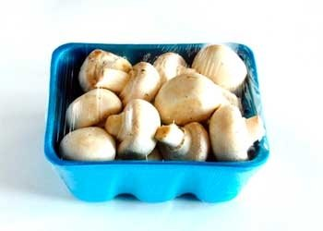
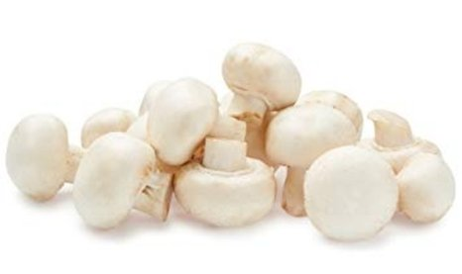
Packaged (fixed weight) versus random weight
Fixed-weight dollar sales outperformed random weight
4 w.e. 12/29/2024 | Share of total mushroom sales and sales growth %
 | Fixed weight | Random weight
Dollar growth | -4.6% | -7.5%
Share of mushroom $ sales | 96.6% | 3.4%
Volume growth | -3.5% | -4.4%
Share of mushroom lbs sales | 97.0% | 3.0%
Source: Circana, Integrated Fresh, MULO+, 4 weeks ending 12/29/2024

Slide 19
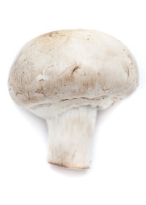
Organic versus conventional mushrooms sales
Organic mushrooms increased volume sales with a shift to larger pack sizes
4 w.e. 12/29/2024 | Share of total mushroom sales and sales growth %
Market
size
$93.0M
$ growth
-6.6%
Unit growth
-4.1%
Volume
growth
-5.2%
Conventional
Market size
$27.9M
$ growth
+1.6%
Unit growth
+1.2%
Volume
growth
+3.2%
Organic
Source: Circana, Integrated Fresh, MULO+, 4 weeks ending 12/29/2024 compared with year ago

Slide 20
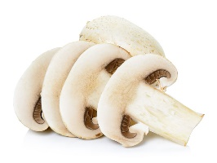
Value added versus whole mushrooms
Whole outperformed value-added mushrooms
4 w.e. 12/29/2024 | Share of total mushroom sales and sales growth %
Market
size
$73.9M
$ growth
-3.1%
Unit growth
-1.1%
Volume
growth
-2.5%
Whole
Market size
$47.1M
$ growth
-7.3%
Unit growth
-6.4%
Volume
growth
-5.4%
Value-added
Source: Circana, Integrated Fresh, MULO+, 4 weeks ending 12/29/2024 compared with year ago

